Slide 1
Puberty Year 4 and 5

Slide 2
What is Relationships and health education?
From September 2020, all primary age children will be taught Relationships and Health Education.
These subjects are designed to equip your child with knowledge to make informed decisions about their wellbeing, health and relationships as well as preparing them for a successful adult life. The world for all young people looks very different from the way it did 20 years ago when this curriculum was last updated – these changes bring the content into the 21st century, so that it is relevant for your child.

Slide 3
Relationships education
Your child will be taught what a relationship is, what friendship is, what family means and who can support them. In an age-appropriate way, your child’s school will cover how to treat each other with kindness, consideration and respect.
By the end of primary school, pupils will have been taught content on: • families and people who care for me • caring friendships • respectful relationships • online relationships • being safe

Slide 4
Health education
Health Education aims to give your child the information they need to make good decisions about their own health and wellbeing, to recognise issues in themselves and others, and to seek support as early as possible when issues arise.
By the end of primary school, pupils will have been taught content on: • mental wellbeing • internet safety and harms • physical health and fitness • healthy eating • facts and risks associated with drugs, alcohol and tobacco • health and prevention • basic first aid • changing adolescent body

Slide 5
What will the puberty teaching look like in year four?
We will look at this area of the RSHE curriculum in the second half of the summer term. Your child may start asking more questions at home, or begin to use new vocabulary, so we felt it was important to give you the opportunity to know what we would teach the children at this point.
The children will all be taught together so they are able to all hear the information at the same time. The session will be led by the class teacher. The children will have had some previous sessions in other year groups about keeping clean etc – you can see the progression on the overview on our school website.

Slide 6
My body:
My body is changing
I can name parts of my body.
I can talk about the different parts of my body and what they do.
I can describe the changes that take place with puberty.
I understand how to maintain personal hygiene.

Slide 7
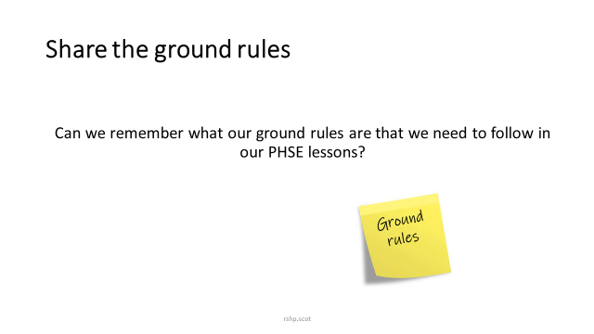

Slide 8

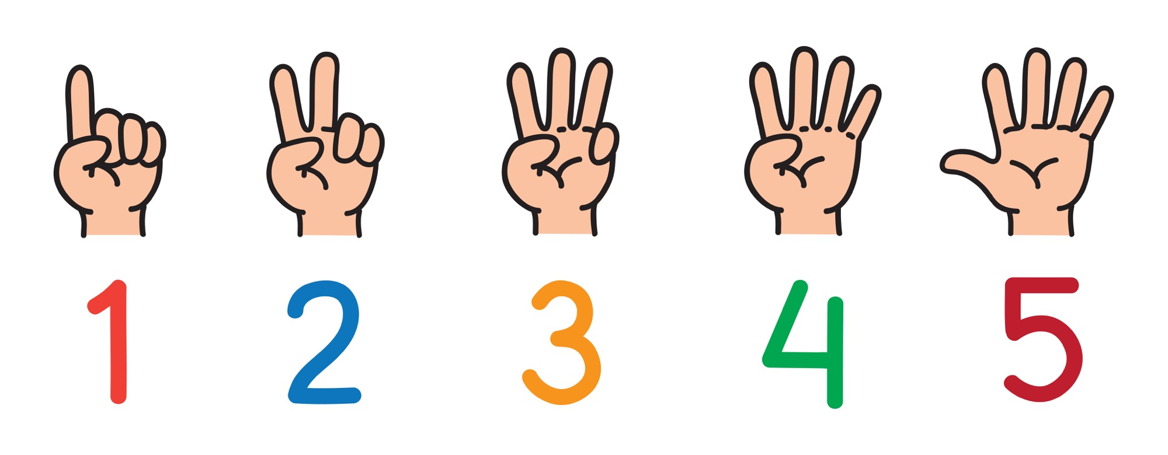
Can you name 5 ways your body has changed since you were a baby?

Slide 9


What is puberty?
Puberty is the time in your life when your body begins to change.
Some changes you can see.
Some changes happen inside your body. You can’t see these.
You can have stronger emotions and new feelings.

Slide 10
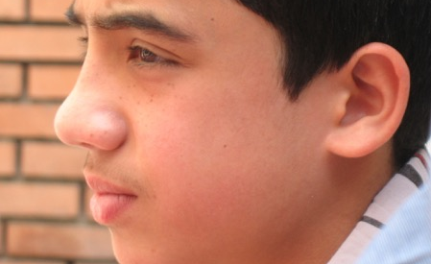
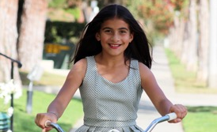
When will puberty happen to me?
Puberty changes happen over several years. Usually between the ages of 9 and 16.
Some changes in your body might be happening now, some will happen later. This is different for everybody.

Slide 11

All the changes that happen during puberty are caused by chemicals in your body. These chemicals are called Hormones.
When your body is ready to begin puberty, your pituitary (say: pih-TOO-uh-ter-ee) gland (a pea-shaped gland located at the bottom of your brain) releases these special hormones.
Depending on whether you're a boy or a girl, these hormones go to work on different parts of the body.

Slide 12
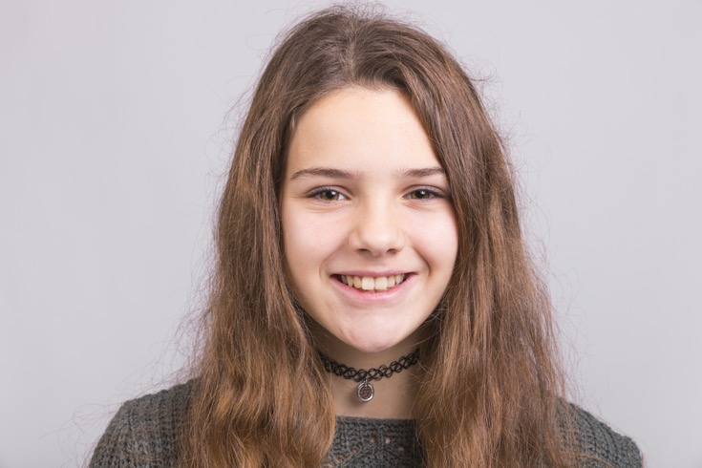
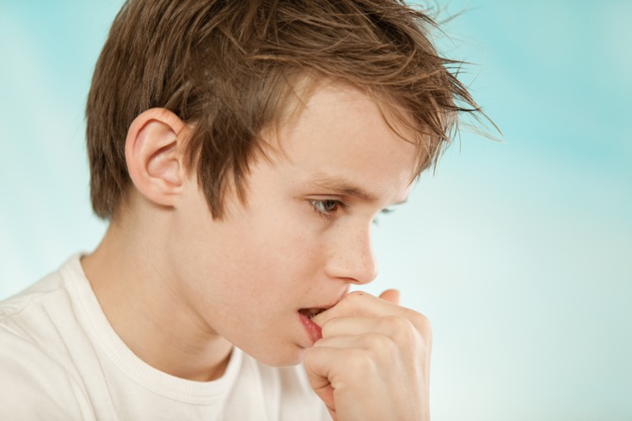
When we go through puberty what happens to…
Hair?
Skin?
Body shape?
Breasts?
Voices?
Smell?

Slide 13
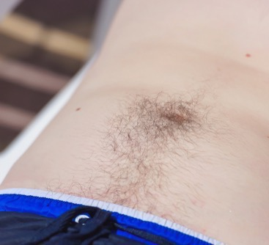
What happens to hair?

Slide 14
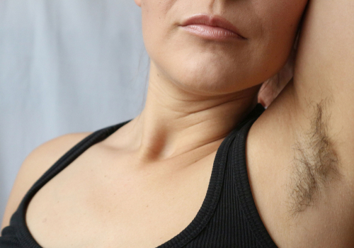
Hair
Hair can grow on your face, around your genitals (private parts), arm pits (under your arms) and on your body.
Head hair can get oily and need washed more often.

Slide 15
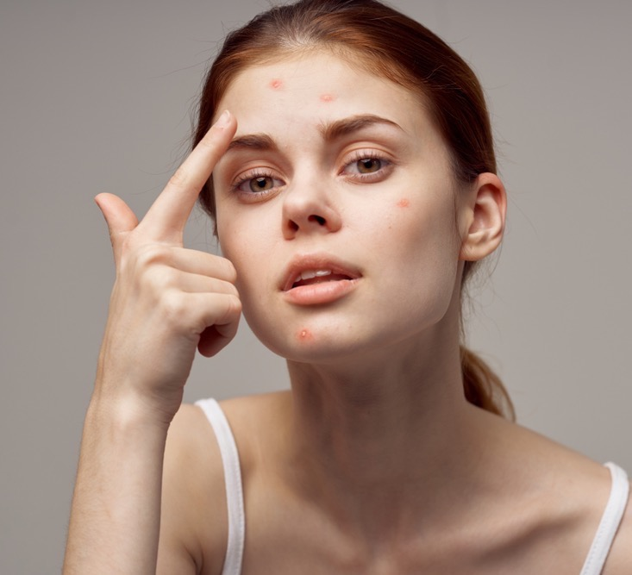
What happens to skin?

Slide 16
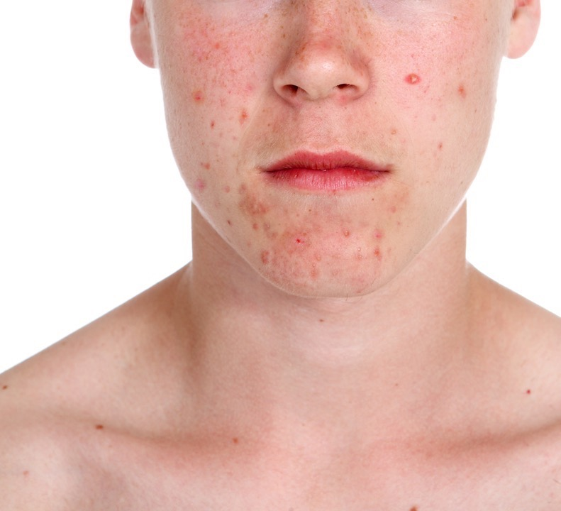
Skin
Both girls and boys can get spots (acne).
Spots happen because your skin gets oilier.

Slide 17
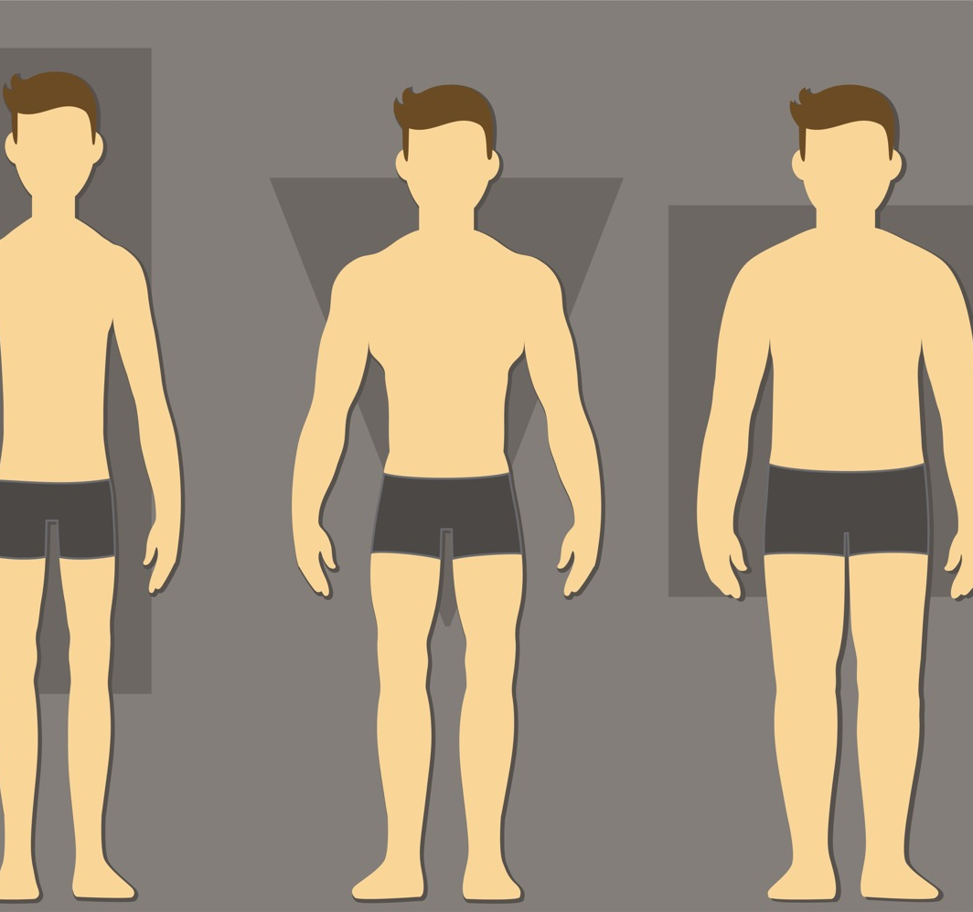
What happens to body shape?

Slide 18
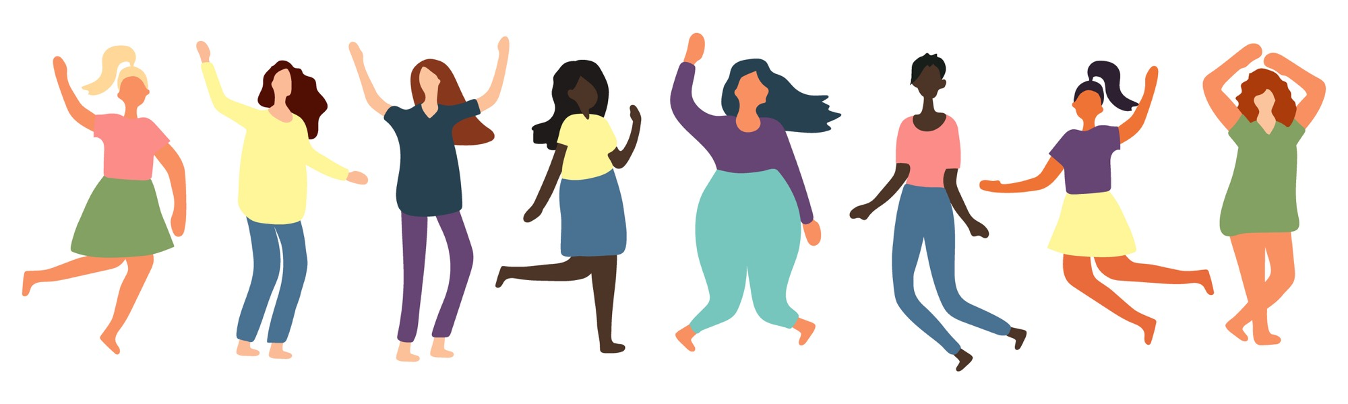
Body shape
Boys and girls grow taller.
Boys get broader across the shoulders and their body becomes more muscular.
Girls’ hips widen and their waist becomes narrower.

Slide 19
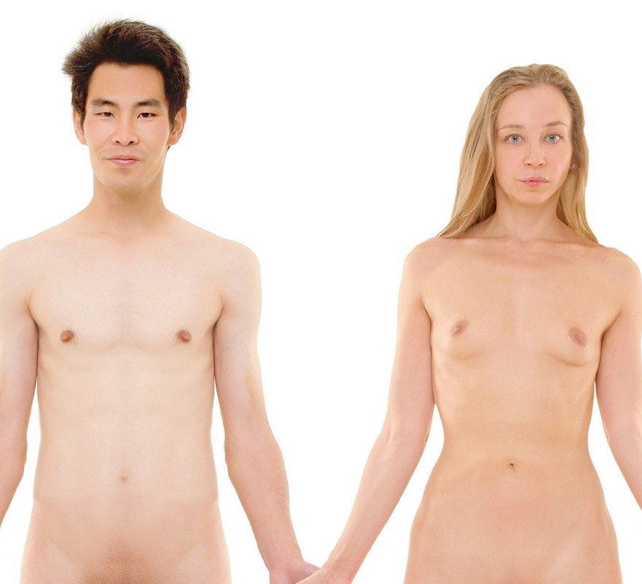
What happens to breasts?

Slide 20
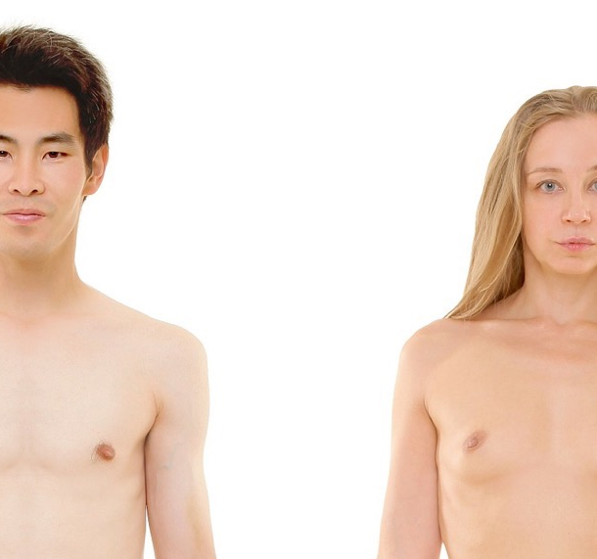
Breasts
Breasts get bigger and rounder as they grow.
Every girls' breasts are different. Boys can sometimes have growth in their breast area too.

Slide 21
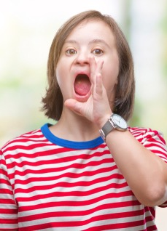

What happens to voices?

Slide 22

Voices
Boy’s voices can get deeper.
Girls voices might become deeper too. This happens over time.

Slide 23
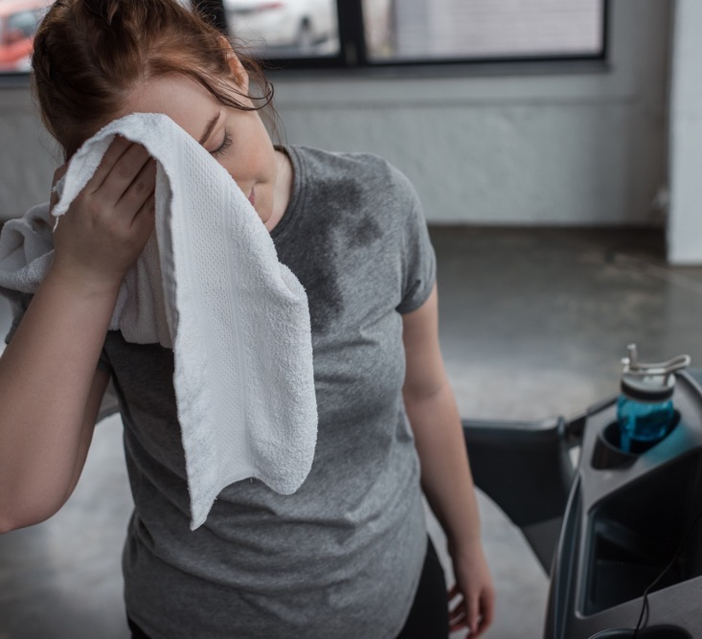
What happens to body smells?

Slide 24
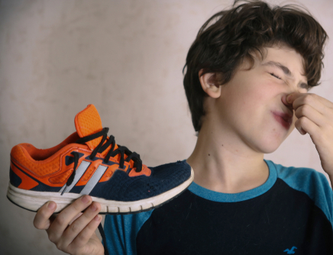
Smell
Boys and girls sweat more when they go through puberty.
Sweat can make your clothes or body smelly.
It is important for girls and boys to wash themselves and change clothes more often.

Slide 25

Some changes that happen to boys and girls are to get your body ready to have a baby when you grow up, if you want to.

Slide 26
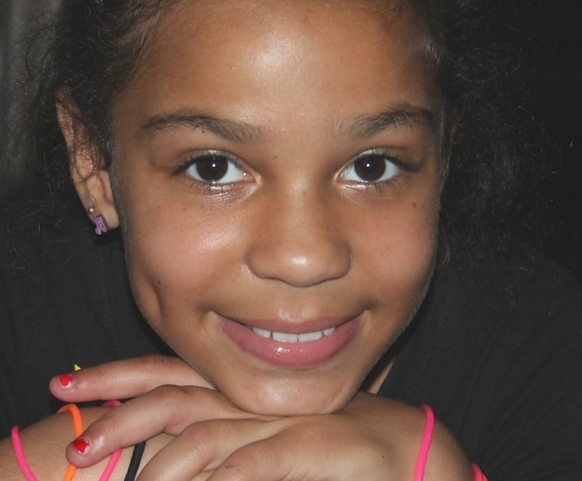
Periods
When a girl goes through puberty her ovaries release an egg every month.
For a few days each month blood and other fluids pass out through the girl’s vagina. There can be some fluids called pre-period discharge before the period starts.
Periods are also called menstruation.

Slide 27
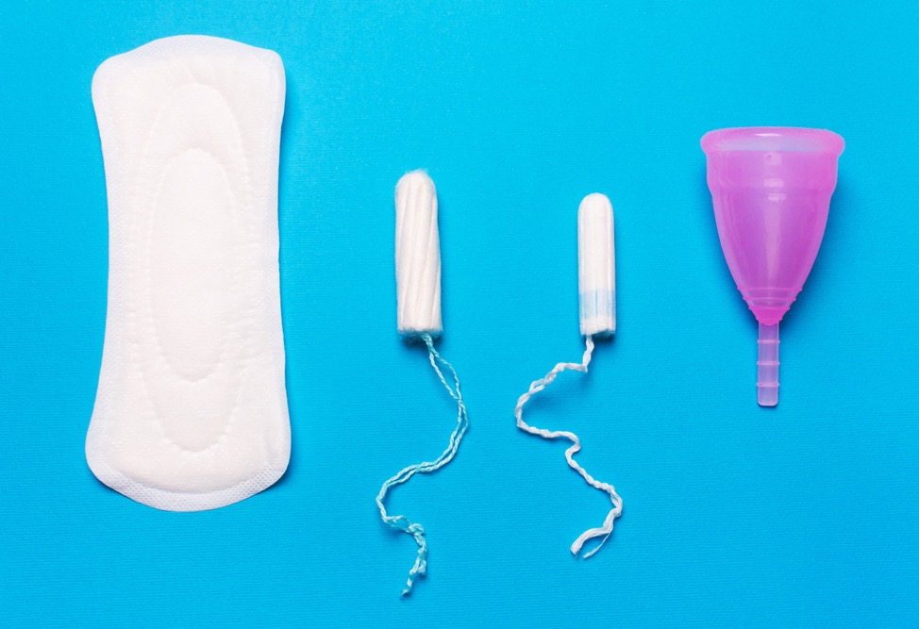
When a girl has her period she wears a sanitary towel or tampon or menstrual cup to absorb the fluid.

Slide 28

During a period, girls can feel that it is a bit painful or uncomfortable.
A girl can still do anything she wants when having her period.
It’s important to remember that not all girls have periods. Every girl is different and unique!

Slide 29
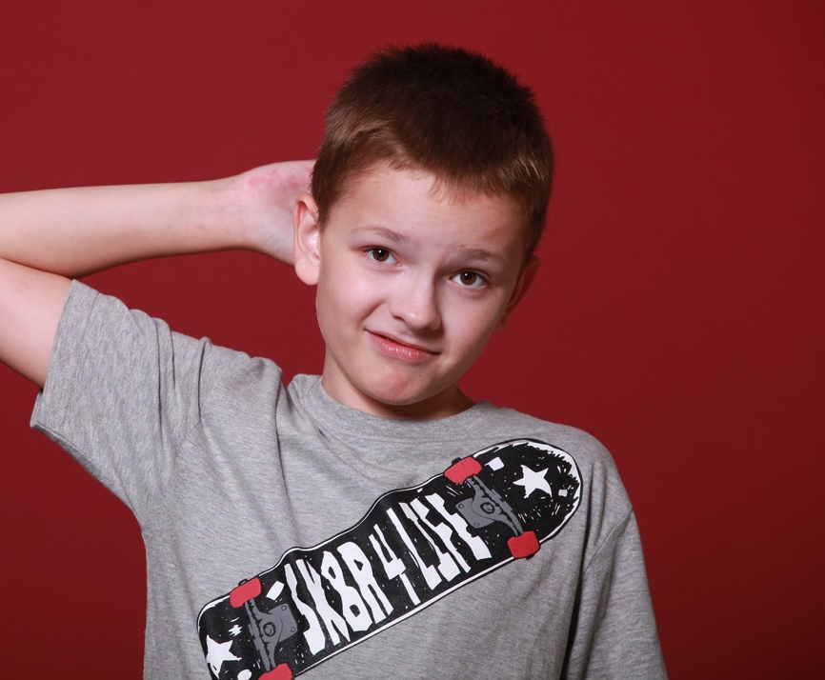
Erections
An erection is when the boy’s penis goes hard and sticks out from his body.
Erections are normal. They can happen at any time. After a while the erection will stop and the penis will be soft again.

Slide 30

Touching your private parts
Your parent or carer may ask you about your private parts or see them, to help you keep them clean or help you if you are not well.
When you are with your parent or carer a doctor or nurse might ask to see your private parts. No-one else should ask to see or touch your private parts.

Slide 31

What have we learned about today that’s been most interesting for you?
Any questions…

Slide 32
What will the puberty teaching look like in year five?
Pupils will be given the opportunity to revisit puberty in both the Science curriculum (looking at changes from birth to old age) and also within the RSHE curriculum.
The session will provide a bit more detail from the learning the children did in Year Four. Pupils will be taught together primarily and will then be put into smaller groups to provide a more focused question and answer session.
Parents do not have the right to withdraw their children from these sessions .

Slide 33
I can name parts of my body.
I can talk about the different parts of my body and what they do.
I can describe the changes that take place with puberty.
I understand how to maintain personal hygiene.
Puberty

Slide 35
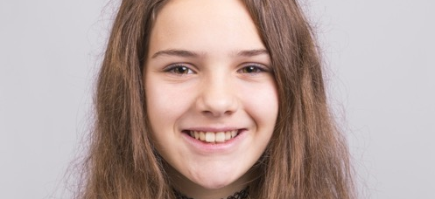
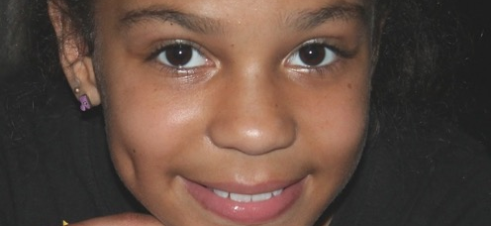
Periods
Periods are also called menstruation.
Most girls start their period between the age of 10 and 16.
Some girls start earlier, some later.
It’s important to remember that not all girls have periods.
All girls are different and unique.

Slide 36
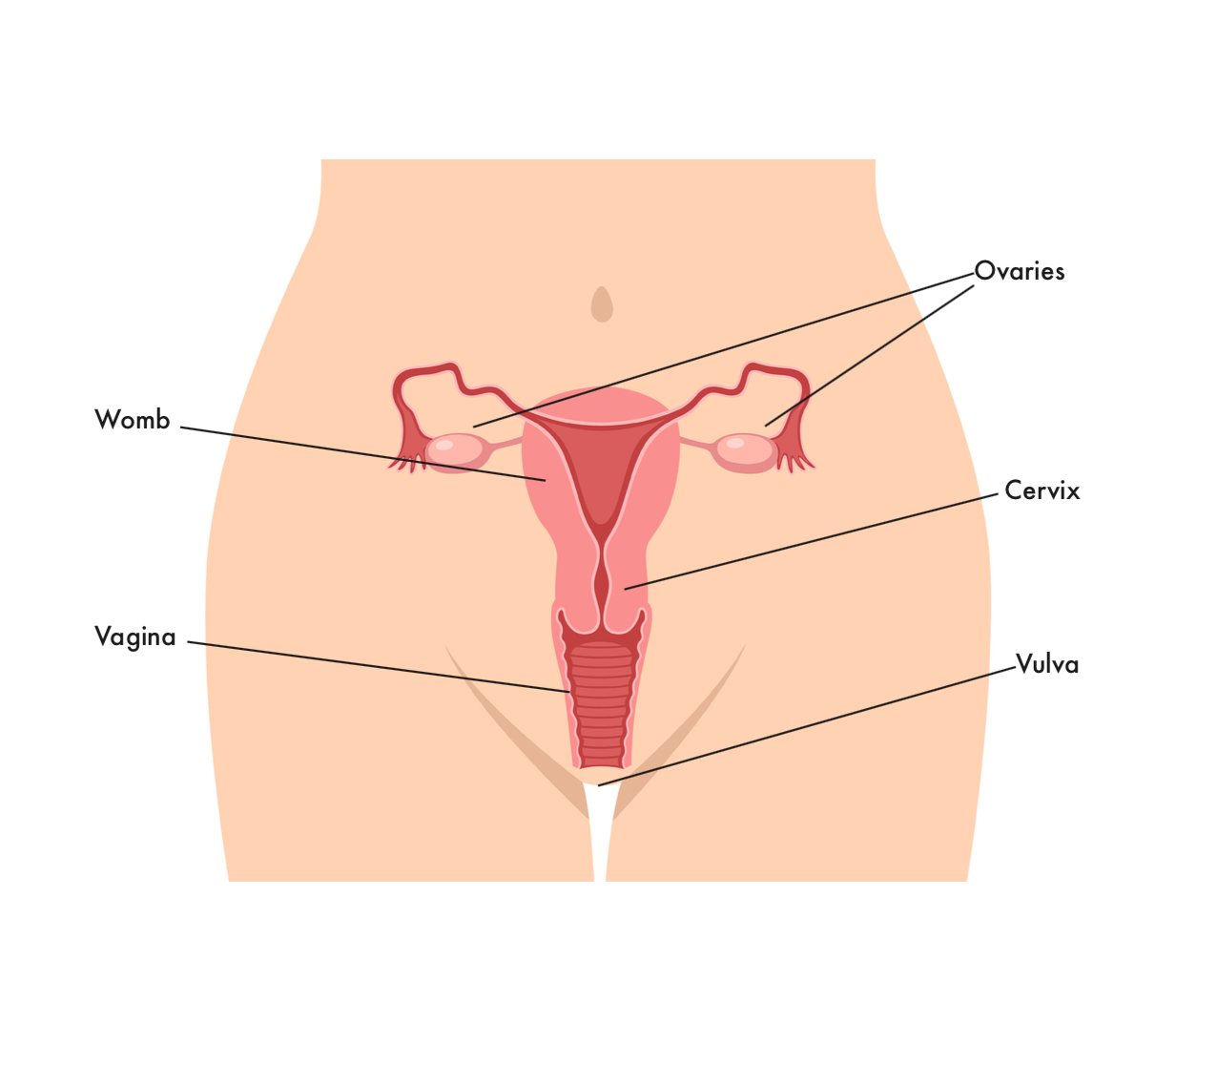
Female body parts

Slide 37
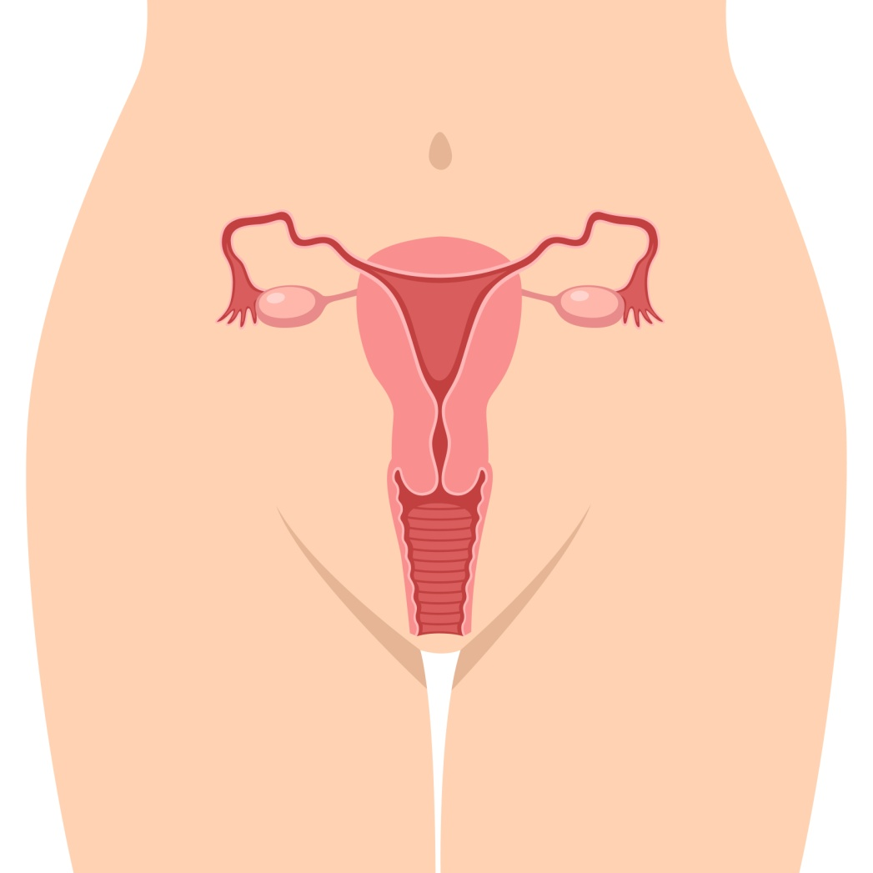
When a girl goes through puberty her ovaries release an egg every month.
For a few days each month blood and other fluids pass out through the girl’s vagina.
There can be some fluids called pre-period discharge before the period starts.

Slide 38
When a girl has her period she wears a sanitary towel or tampon or menstrual cup to absorb the fluid.

Slide 39
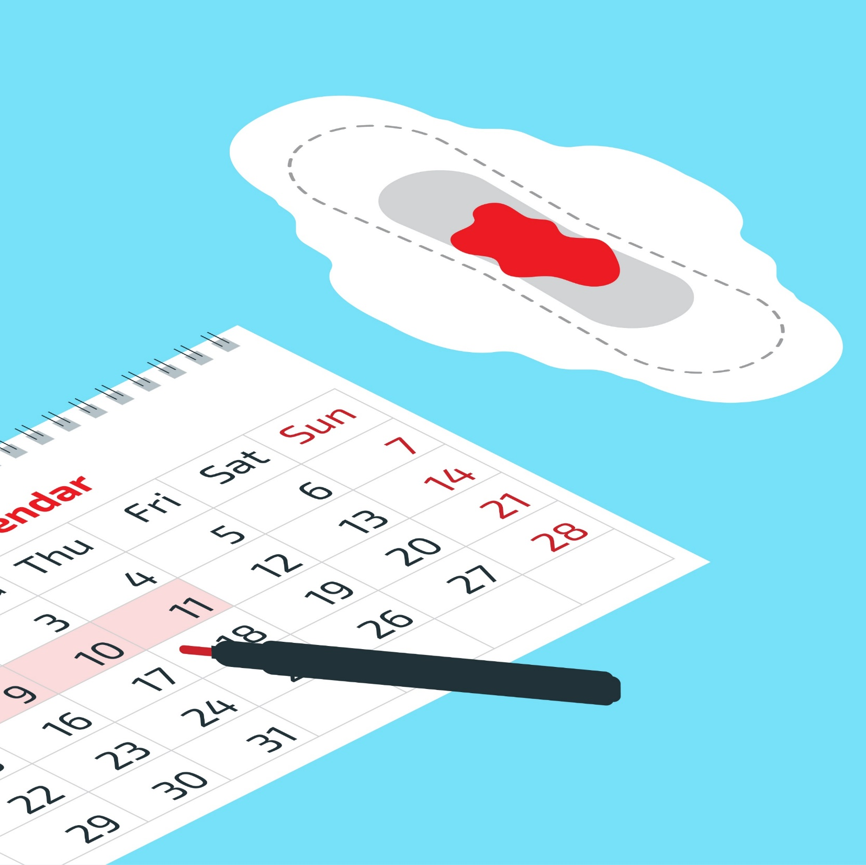
Periods usually last a few days each month.
Some girls mark the start of their period on a calendar.
It helps her to remember to take sanitary wear to school.

Slide 40
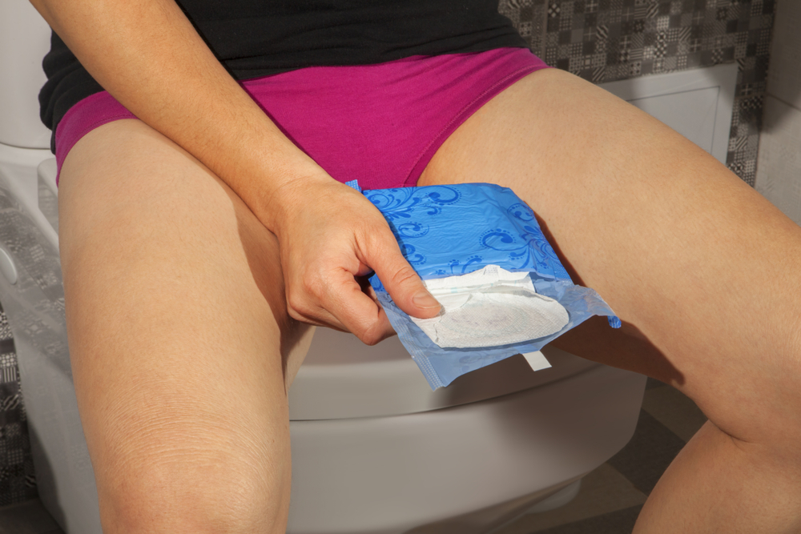
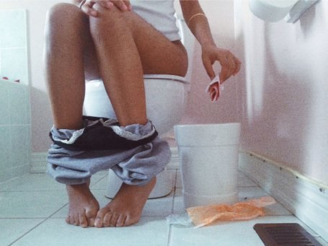
A girl will need to change her sanitary towel or tampon a few times a day.
Used sanitary wear should go in the bin.

Slide 41
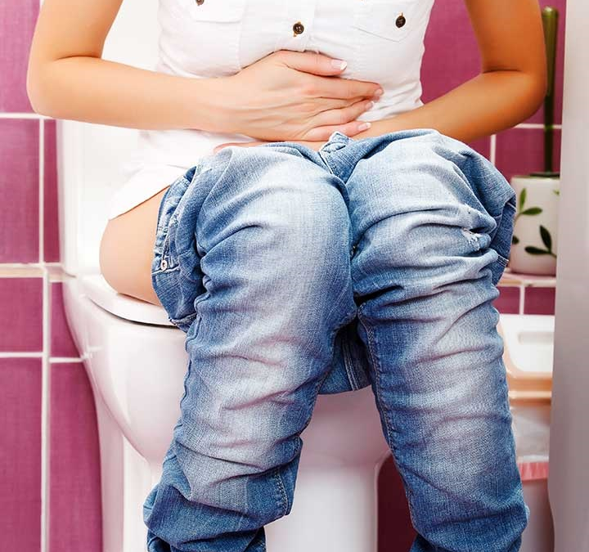
Some girls might experience pain or discomfort during their period.
If you have any questions or worries about periods, you should talk to a trusted adult.

Slide 42

Menstruation: What to expect
(duration 3 minutes 18) https://youtu.be/DBe7-PHRav8

Slide 43
Period hygiene: Tampons, Pads and Menstrual Cups
(duration 2 minutes 9) https://youtu.be/kmWbOC8Fbb0

Slide 44
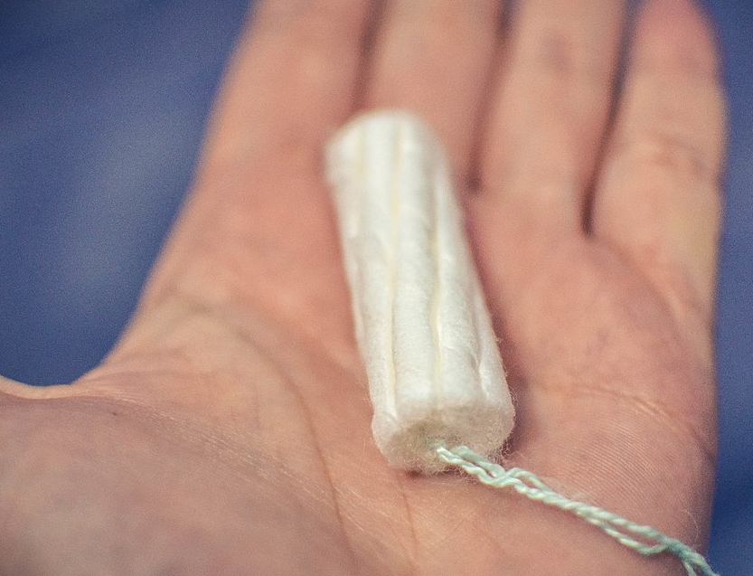
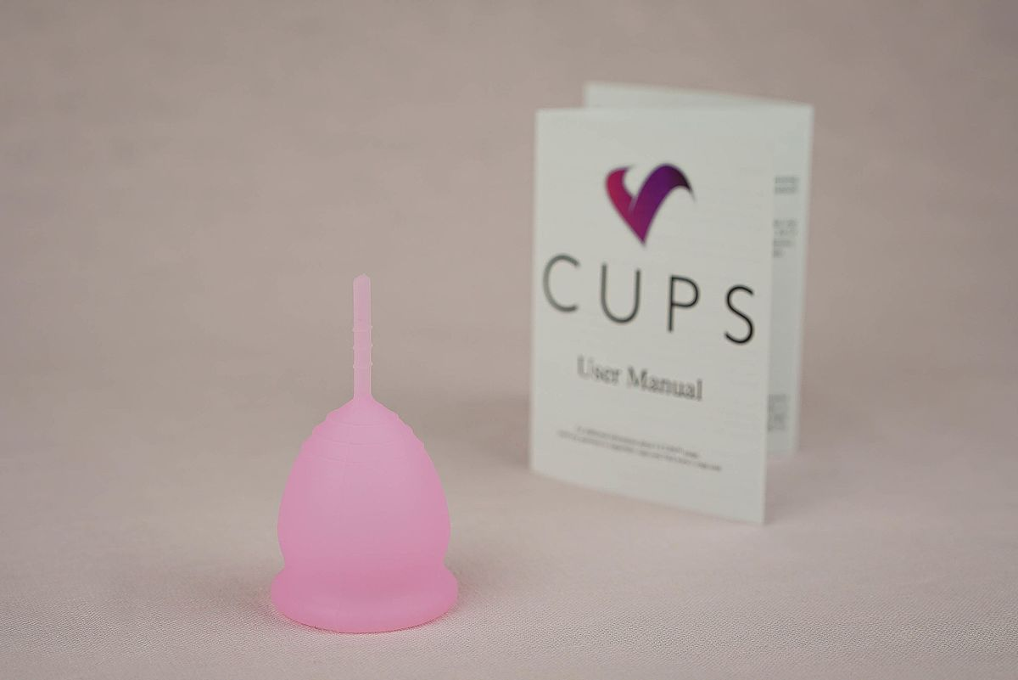
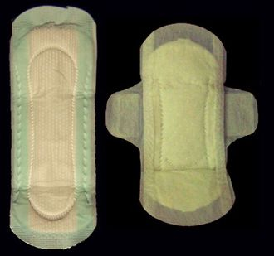

Explore the products…

Slide 45


Menstruation:
True or False?
This activity ©Hey Girls CIC 2019. Reproduced with kind permission of the owner.

Slide 46

True or False?
A period is when someone pees blood.

Slide 47

A period is when someone pees blood.
FALSE: Period blood does not come from the urethra (pee tube). It is part of a separate bodily system and comes from the womb, leaving the body through the vagina.

Slide 48
True or False?
A period is when someone loses a lot of blood each month.

Slide 49
A period is when someone loses a lot of blood each month.
FALSE: The average blood loss is around 1-2 egg cups full, but it can look like more. If someone is losing a lot of blood they should see their doctor.

Slide 50
True or False?
A period is the name for shedding the lining of the womb.

Slide 51

A period is the name for shedding the lining of the womb.
TRUE

Slide 52
True or False?
A period always comes every 28 days.

Slide 53


A period always comes every 28 days.
COULD BE TRUE OR FALSE: the average cycle is around 25-35 days. It will be different for everyone.

Slide 54
True or False?
The start of a period is Day 1 of the menstrual cycle.

Slide 55
The start of a period is Day 1 of the menstrual cycle.
TRUE

Slide 56
True or False?
A period is made up of blood alone.

Slide 57
A period is made up of blood alone.
FALSE: Period blood is a mixture of tissue, blood & mucus.

Slide 58
True or False?
A period always lasts for 5 days.

Slide 59
A period always lasts for 5 days.
FALSE: period length varies from person to person, it normally lasts between 3-7 days

Slide 60
True or False?
You can hold in a period like you can hold in a wee.

Slide 61
You can hold in a period like you can hold in a wee.
FALSE: The muscles in the vagina are not like the muscles in the urethra, you cannot stop or start period flow at will, it just drips out. This is why period products are used.

Slide 62
True or False?
Period flow is always bright red.

Slide 63
Period flow is always bright red
COULD BE TRUE OR FALSE: Period flow can vary in colour from brown to bright or very dark red. It may depend on the day of your cycle.

Slide 64
True or False?
Most people with a female body have periods between the ages of around 12 to 55.

Slide 65
Most people with a female body have periods between the ages of around 12-55.
TRUE: There is variation in ages but most biological females will have regular periods between these ages.

Slide 66
True or False?
Periods are natural and a normal part of growing up for anyone with a female body.

Slide 67
Periods are natural and a normal part of growing up for anyone with a female body.
TRUE

Slide 68
True or False?
All period products are thrown away after use.

Slide 69
All period products are thrown away after use
FALSE: Some period products are disposable (used once and thrown away) and some are reusable (used, washed and used again many times).

Slide 70

Toxic Shock Syndrome is a rare but serious illness that you can get if you leave a tampon in for a long time. Always use the lightest absorbency for your flow and change tampons every 4-6 hours (maximum 8 hours). If you have a fever and think you might have toxic shock, go to the doctor
Never flush period products down the toilet. Always put them in a bin

Slide 71
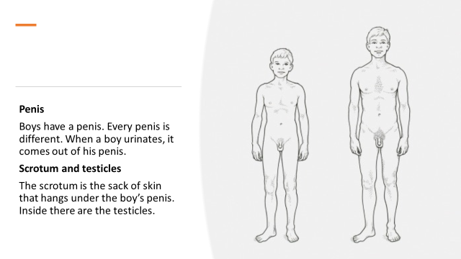

Slide 72
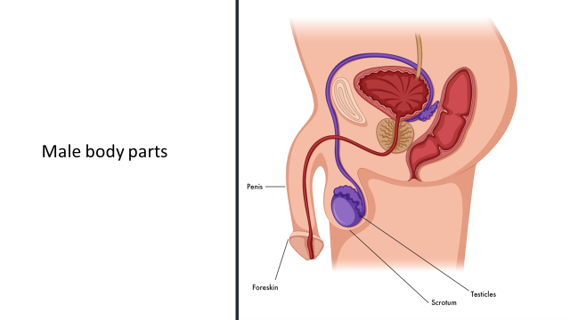

Slide 73
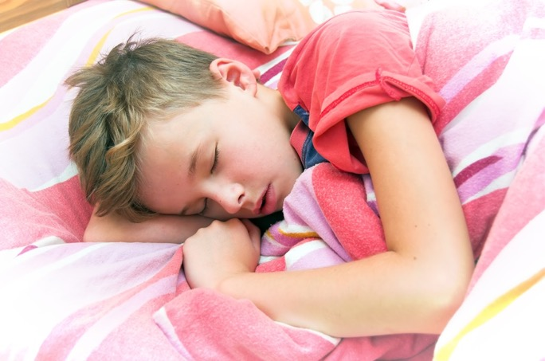
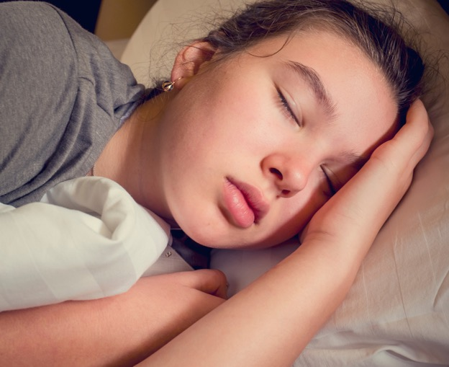
Wet dreams
When a boy is asleep he can get an erection. He might ejaculate. Ejaculation is when semen comes out of the boy’s erect penis.
When a girl is asleep her vulva can become wet and slippery.
Not everyone has wet dreams but if you do this is normal.
If you wake up in the morning and your underwear and sheets are wet and sticky, you had a wet dream. Take off your underwear and pyjamas. Remove your sheets. Wash yourself and put on clean underwear and clothes.

Slide 74
What have we learned about today that’s been most interesting for you?
Any questions…

