Slide 1
SEX EDUcation

Slide 2
What is Relationships and health education?
From September 2020, all primary age children will be taught Relationships and Health Education.
These subjects are designed to equip your child with knowledge to make informed decisions about their wellbeing, health and relationships as well as preparing them for a successful adult life. The world for all young people looks very different from the way it did 20 years ago when this curriculum was last updated – these changes bring the content into the 21st century, so that it is relevant for your child.

Slide 3
Relationships education
Your child will be taught what a relationship is, what friendship is, what family means and who can support them. In an age-appropriate way, your child’s school will cover how to treat each other with kindness, consideration and respect.
By the end of primary school, pupils will have been taught content on: • families and people who care for me • caring friendships • respectful relationships • online relationships • being safe

Slide 4
Health education
Health Education aims to give your child the information they need to make good decisions about their own health and wellbeing, to recognise issues in themselves and others, and to seek support as early as possible when issues arise.
By the end of primary school, pupils will have been taught content on: • mental wellbeing • internet safety and harms • physical health and fitness • healthy eating • facts and risks associated with drugs, alcohol and tobacco • health and prevention • basic first aid • changing adolescent body

Slide 5
What is sex education?
Sex education is not compulsory in primary schools. The DFE say it is up to
primary schools to determine whether they need to cover any additional
content on sex education to meet the needs of their pupils.
However, it is important that the transition phase before moving to
secondary school supports pupils’ ongoing emotional and
physical development effectively.
The Department for Education continues to recommend therefore that
all primary schools should have a sex education program tailored
to the age and the physical and emotional maturity of the pupils.

Slide 6
It should ensure that both boys and girls are prepared
for the changes that adolescence brings and –
drawing on knowledge of the human life cycle set out in the national curriculum for science - how a baby is conceived and born.
The national curriculum for science also includes subject content in
related areas, such as the main external body parts, the human body as it grows from birth to old age (including puberty) and reproduction in some plants and animals.

Slide 7
Right to withdraw
Primary schools that choose to teach sex education must allow parents a right to withdraw their children. Unlike sex education in RSE at secondary, in primary schools, headteachers must comply with a parent’s wish to withdraw their child from sex education beyond the national curriculum for science.
As set out in the school RSHE policy, which can be found on our website, there is a paragraph that highlights the parents right to withdraw. (See paragraph 8)
Requests for withdrawal should be put in writing using the form found in Appendix 3 of this policy and addressed to the Principal.
Alternative work will be given to pupils who are withdrawn from sex education.

Slide 8
Sex:
How people have sex /
What do they do?
I can name the private parts of my body.
I can talk about how puberty results in physical and emotional changes.
I can describe what sex/sexual intercourse can involve.
I understand that sex is something adults do in a relationship.

Slide 9
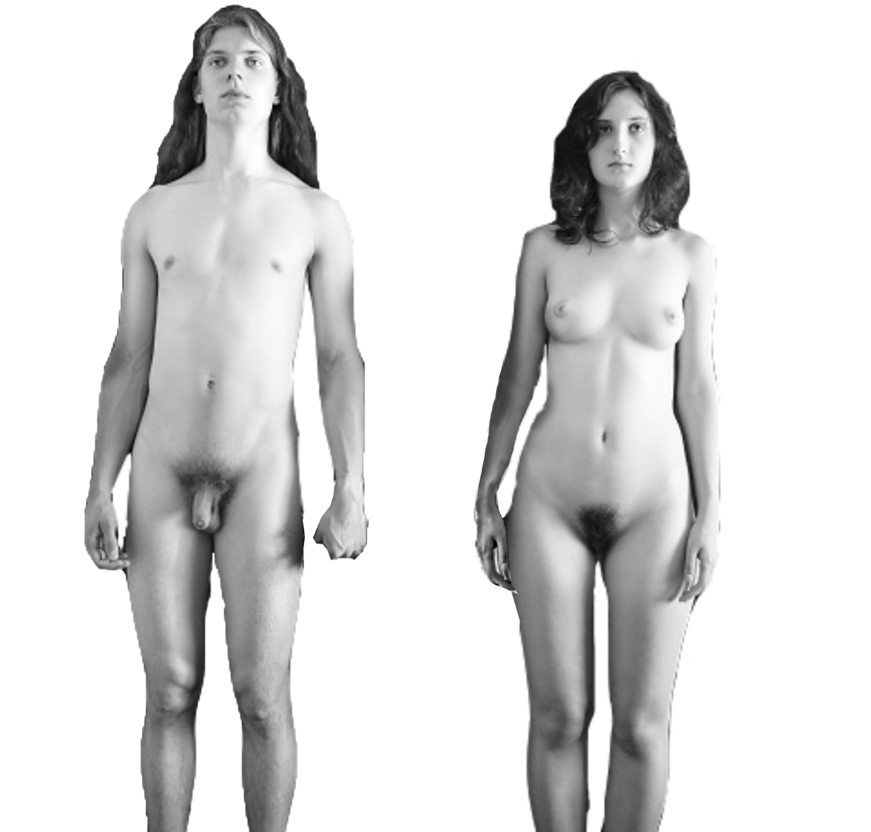
Recap:
Names of parts of the body
Nipples
Nipples
Penis
Vulva
Scrotum

Slide 10
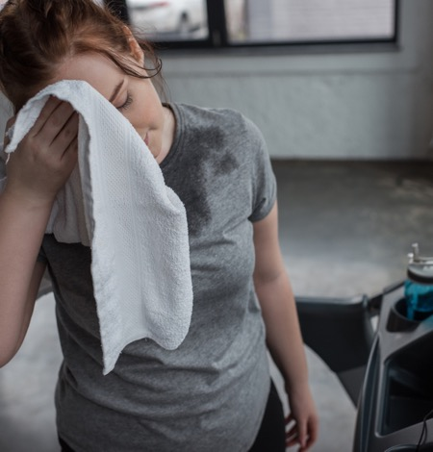
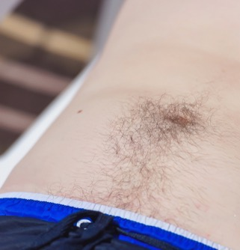
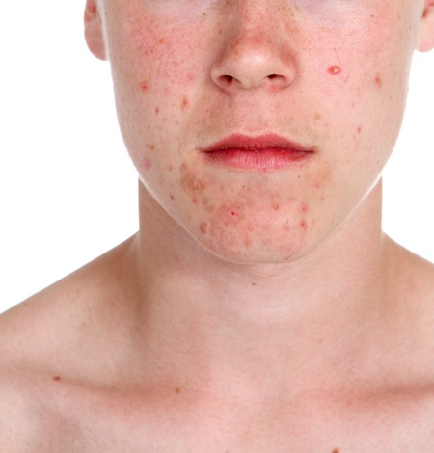
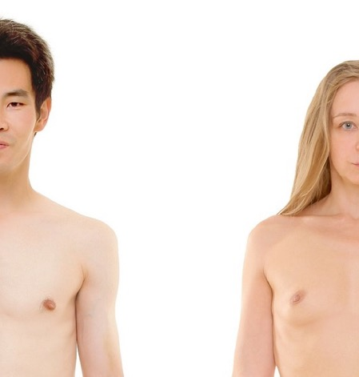
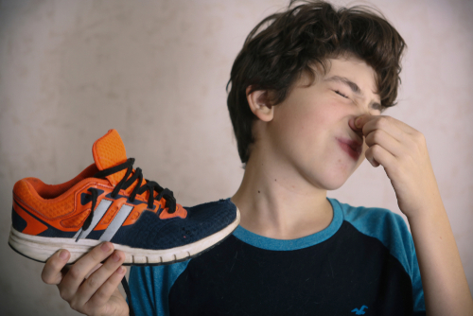
When we go through puberty what happens to:
Hair?
Voices?
Breasts?
Skin?
Smell?
Body shape?

Slide 11


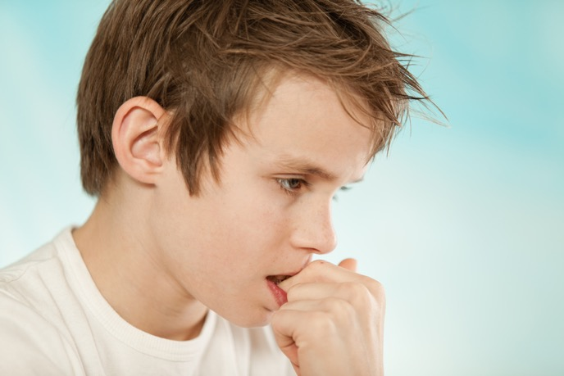

When we go through puberty what happens to our feelings and emotions?

Slide 12

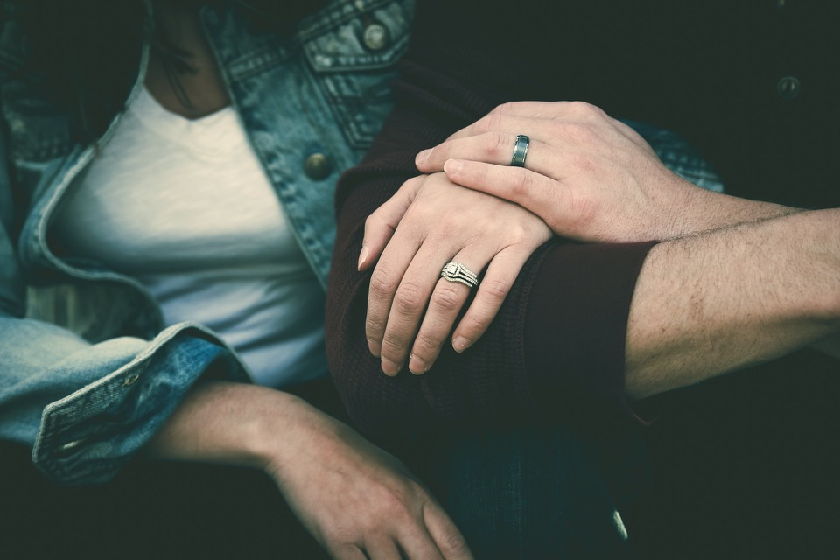

How does a person show love for someone?

Slide 13

What is sex?
Sex is something that adults can do when they love and care for each other. Sometimes people talk about ‘making love’.

Slide 14

You must be 16 years or older to have sex.

Slide 15

When a couple want to have sex they will go to a private place like their bedroom.
They will kiss and cuddle and touch each other’s bodies. They will touch the private parts of each other’s bodies.

Slide 16


Sex should feel nice. Adults learn what they like and don’t like.

Slide 17

When a man feels like he wants to have sex with his partner his penis will get hard, this is called an erection.

Slide 18
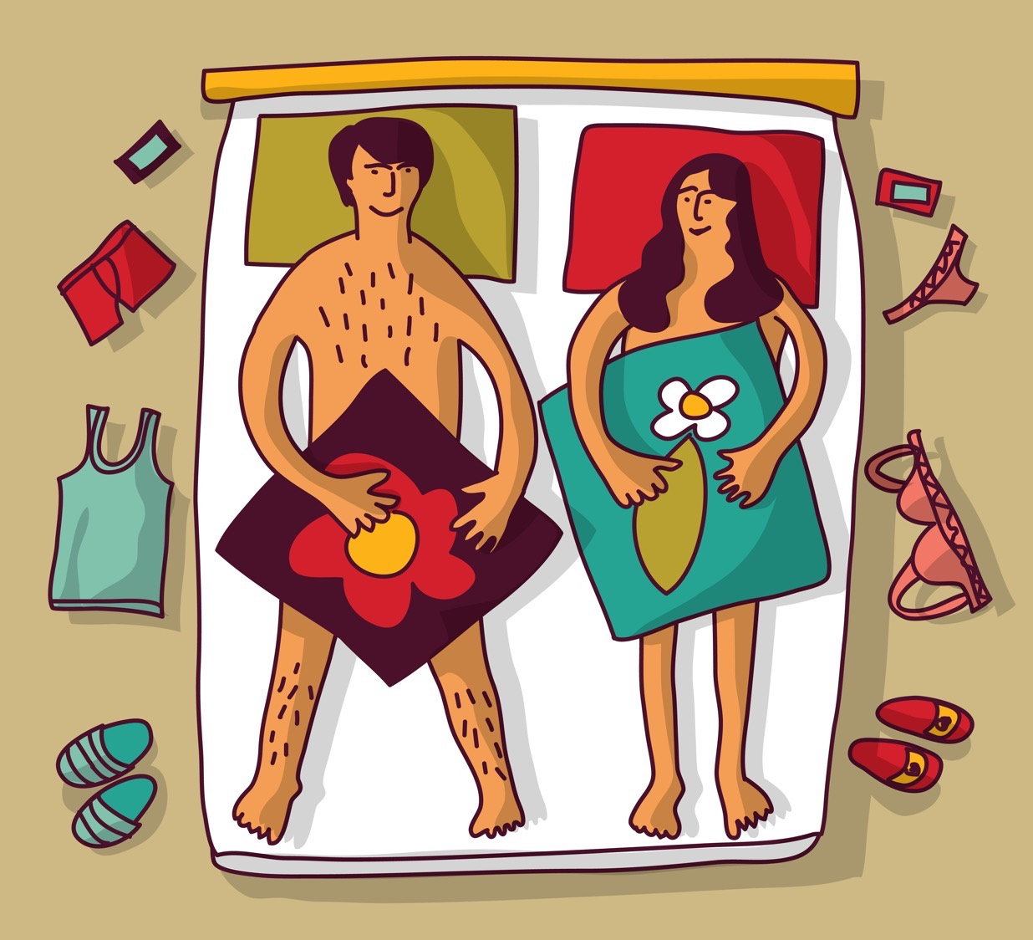
When a woman feels like having sex with her partner her vulva and vagina might feel tingly and wet or slippery to touch.

Slide 19
If a man and a woman are having sex, and they both want to do it, the man can put his penis inside a woman’s vagina and gently move his penis in and out. This should feel nice for both people.

Slide 20
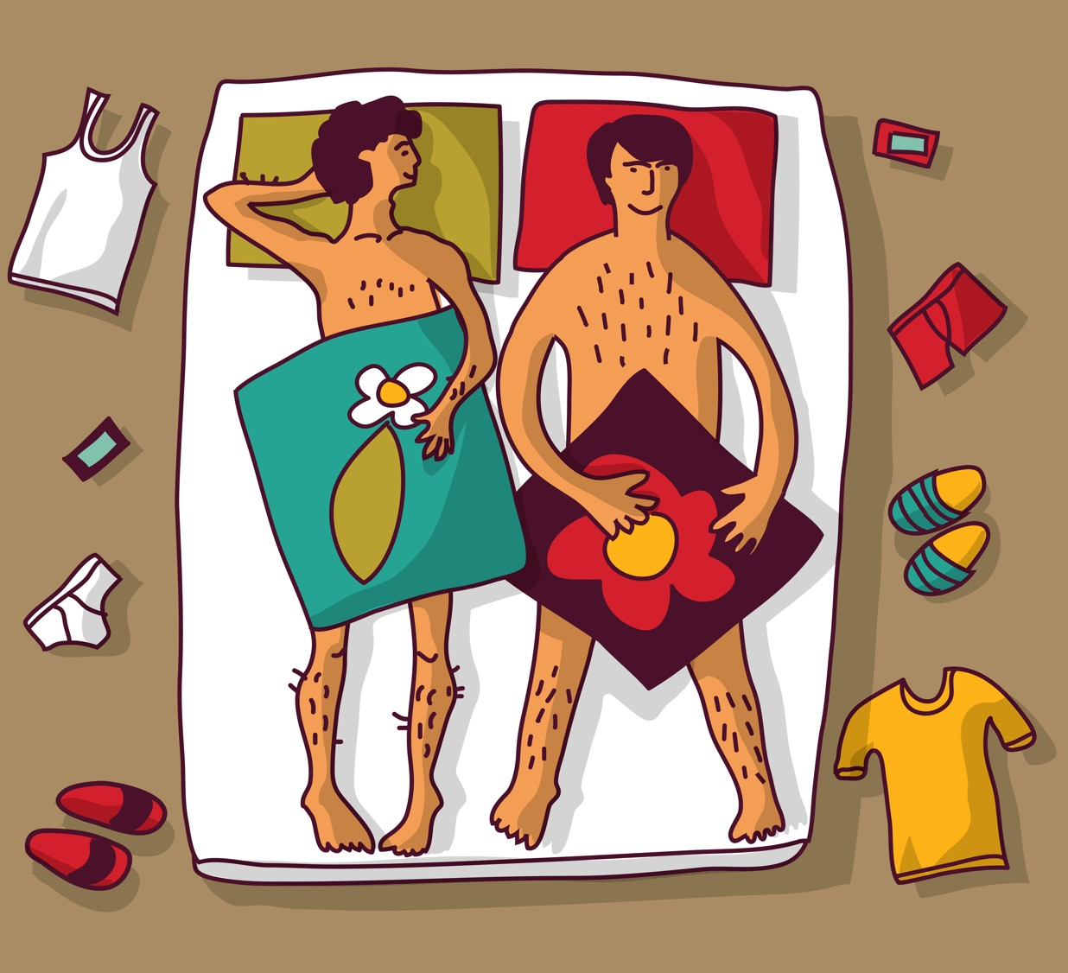
For a man, sometimes a white liquid called semen will come out of his hard penis. This is called ejaculation.

Slide 21


If a man Ejaculates when his penis is inside the woman’s vagina, then the sperm may meet the egg and this is the way a woman can get pregnant and have a baby.

Slide 22

So, this is what sex is. Why do you think adults have sex?

Slide 23

Do you have any questions about sex?

Slide 24
How human life begins, pregnancy and birth
I can explain how human life begins, what pregnancy is and how a baby is born.

Slide 25
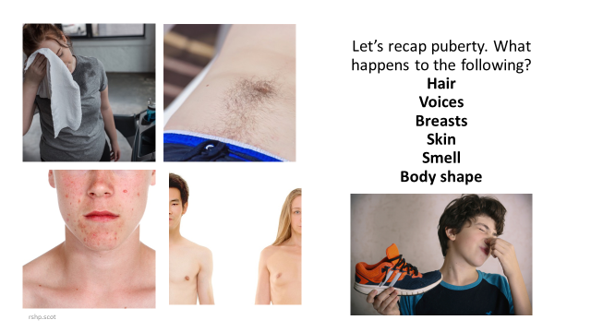

Slide 26
When we go through puberty what happens to our feelings and emotions?

Slide 27
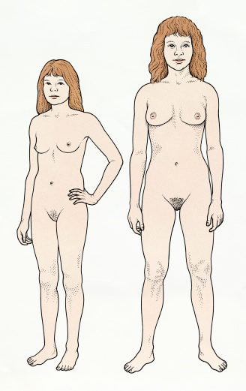
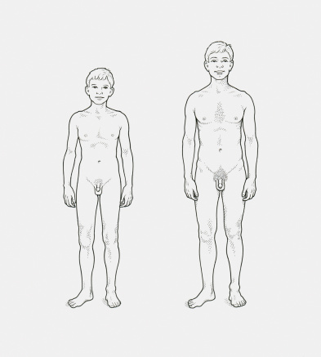
Names of parts of my body

Slide 28
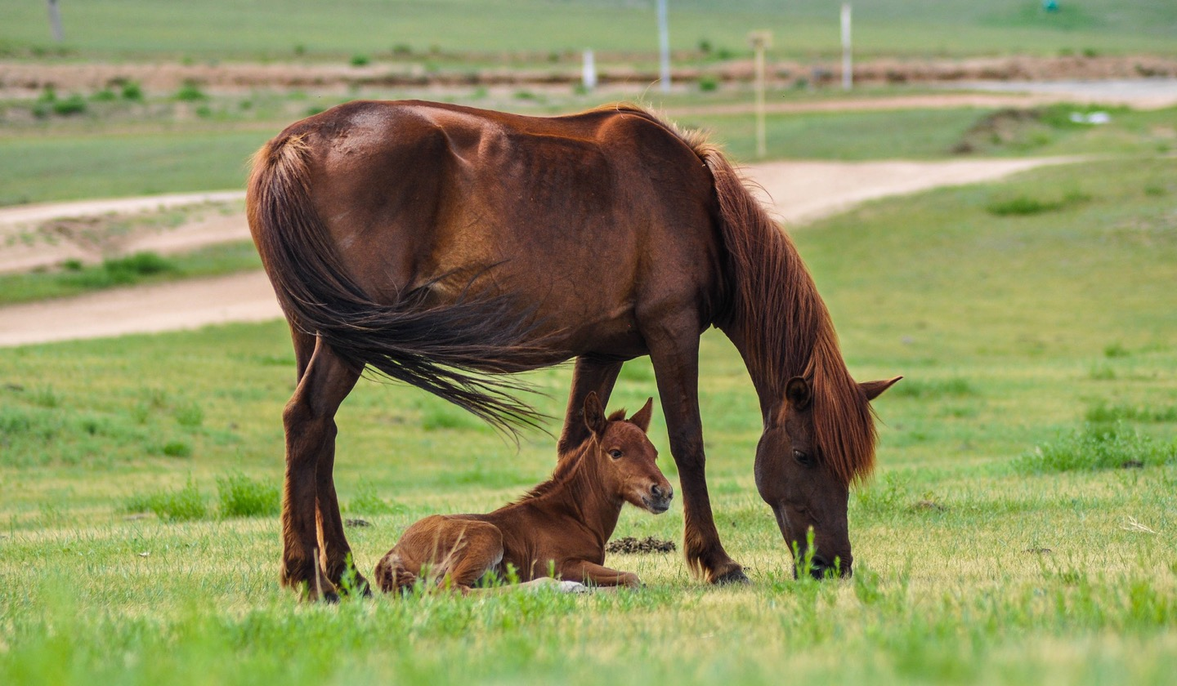
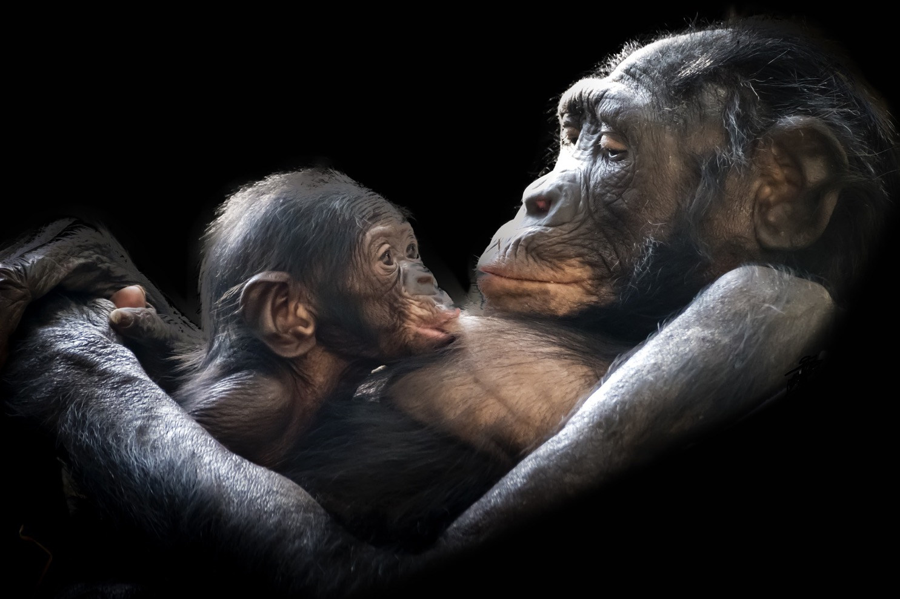
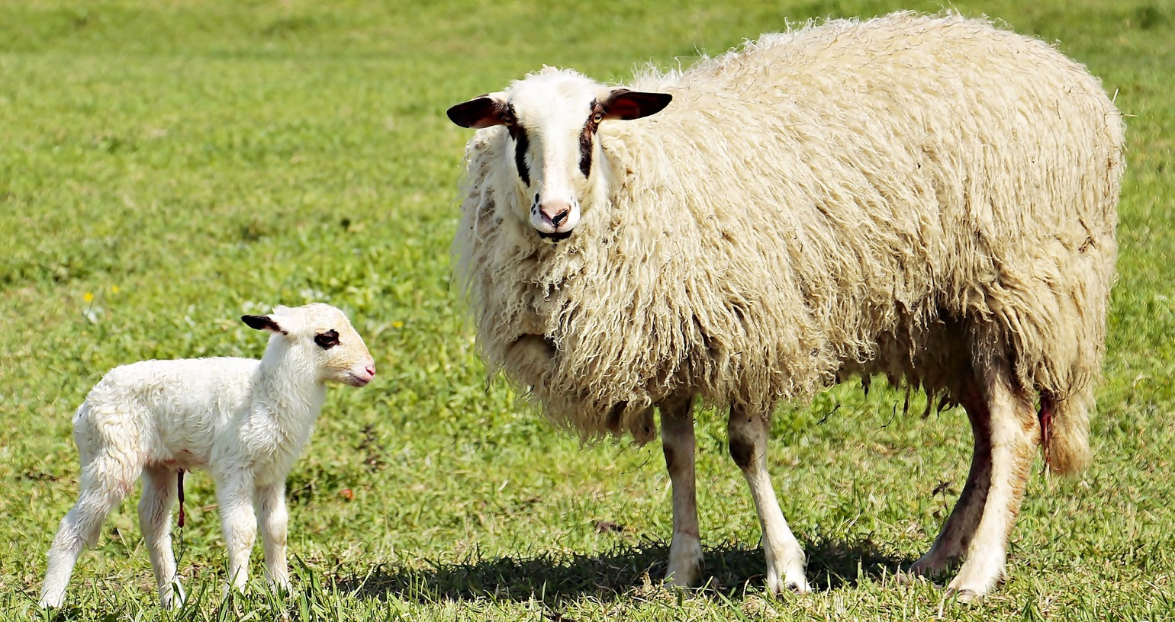
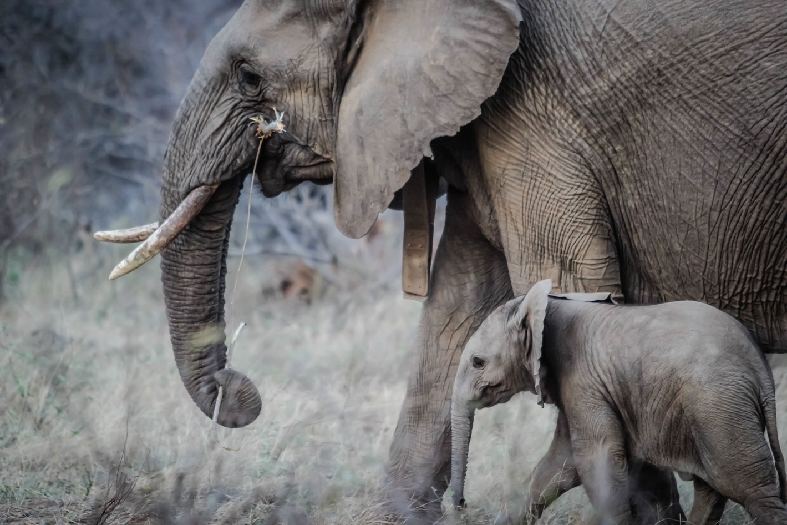

Slide 29
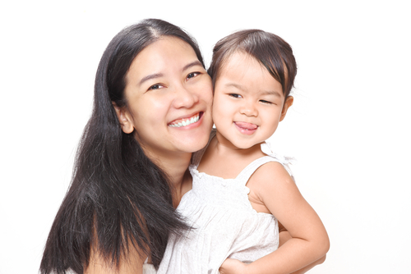

Slide 30
Part 1
How human life begins

Slide 31


A baby is made by adults. To make a baby, you need a tiny little egg from a woman and you need the seed (called the sperm) from a man.

Slide 32
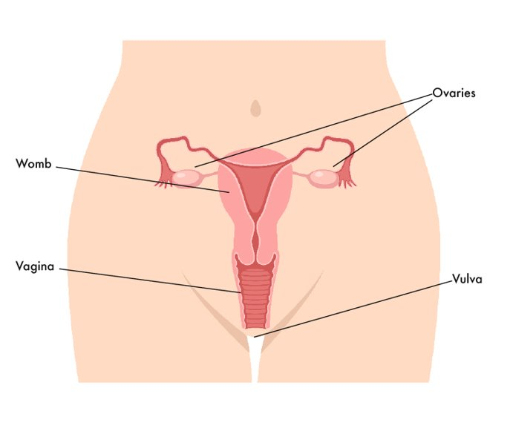
A woman’s eggs are kept inside her body, in her ovaries. Every month a woman releases an egg.

Slide 33
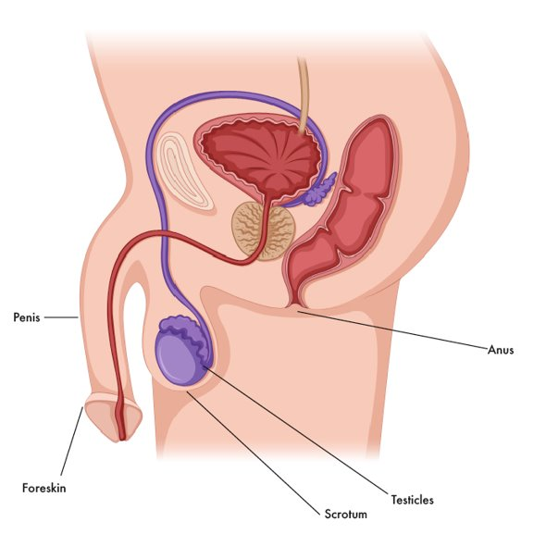
A man’s sperm is made in his testicles which are inside the bag of skin (scrotum) that hangs behind his penis.

Slide 34
When the egg and the sperm come together they can start a baby. This is called fertilisation.
Fertilisation can happen in different ways.

Slide 35



Some parents need help to start the pregnancy.
Some babies start when the egg and sperm come together in a laboratory. The doctor then puts the fertilised egg back into the woman’s womb. This is called IVF.

Slide 36

So, once the egg and sperm meet, then the egg grows in a safe place called the womb. The woman will be pregnant for 9 months.
Let’s watch this short film: Human reproduction
https://www.bbc.com/bitesize/clips/zpmqxnb
(Duration 1 minute 3 seconds)

Slide 37
Part 2
The baby grows - Pregnancy

Slide 38

A baby lives and grows inside the woman’s womb for 9 months.
What will a pregnant woman and her baby need to be healthy, happy and safe?

Slide 39
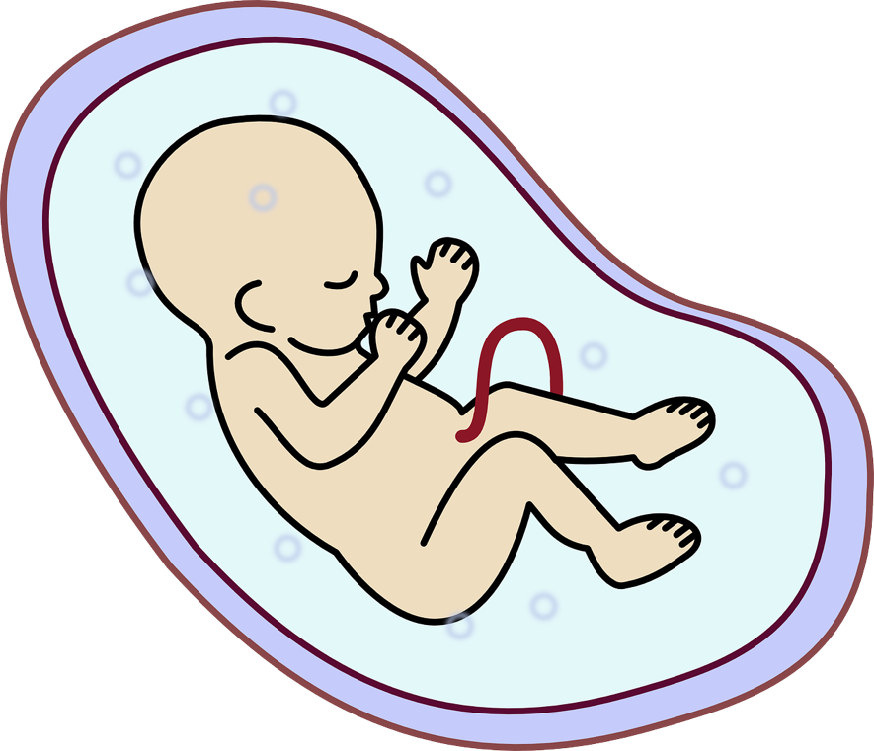
A baby lives and grows inside the woman’s womb for 9 months.
The baby and woman are connected by the umbilical cord that attaches to the baby to the mum. The baby gets everything it needs to grow through the umbilical cord.

Slide 40
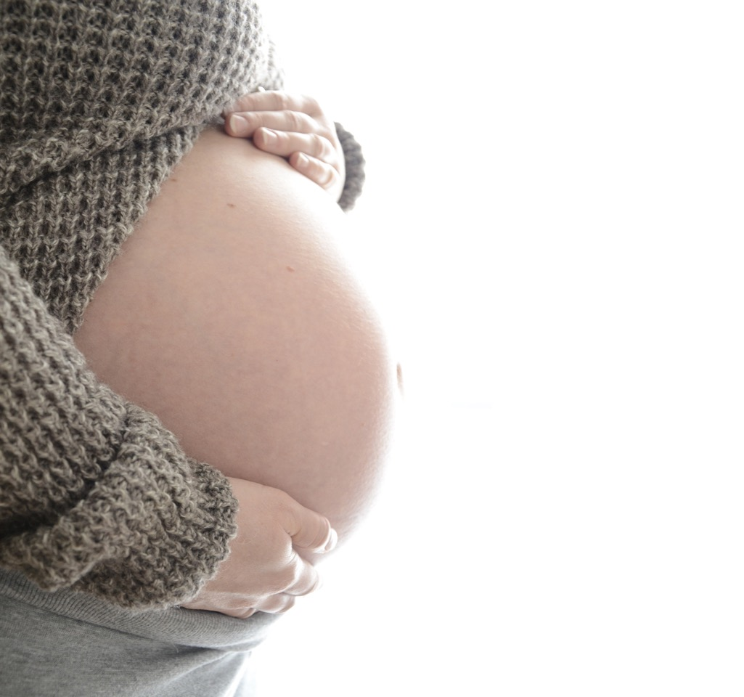
For the baby, the womb is like a bag of warm cosy water and the baby can hear the mum’s heartbeat like a drum.

Slide 41
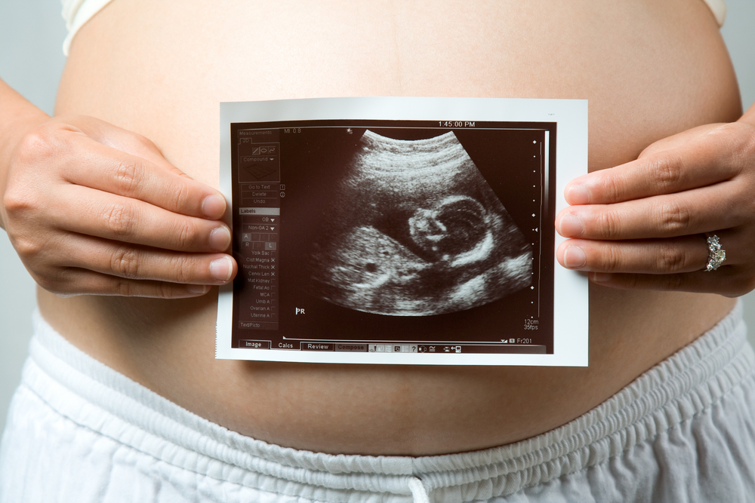
When a woman is pregnant she will go to see the doctor and nurse to make sure everything is going well with her pregnancy.
The woman can take the baby’s dad or her partner or friend with her. Sometimes they get a picture of the baby inside the woman.

Slide 42
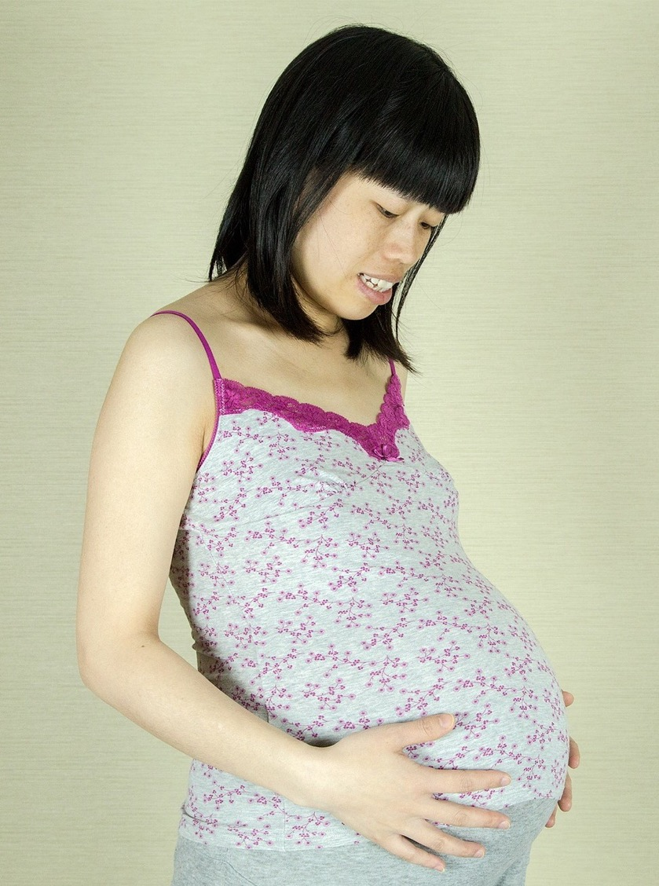
In the final 3 months inside the woman’s womb the baby keeps growing, so much that it needs to be curled up inside the womb. The baby’s brain grows all this time too.
The baby is getting stronger and getting ready to be born.

Slide 43
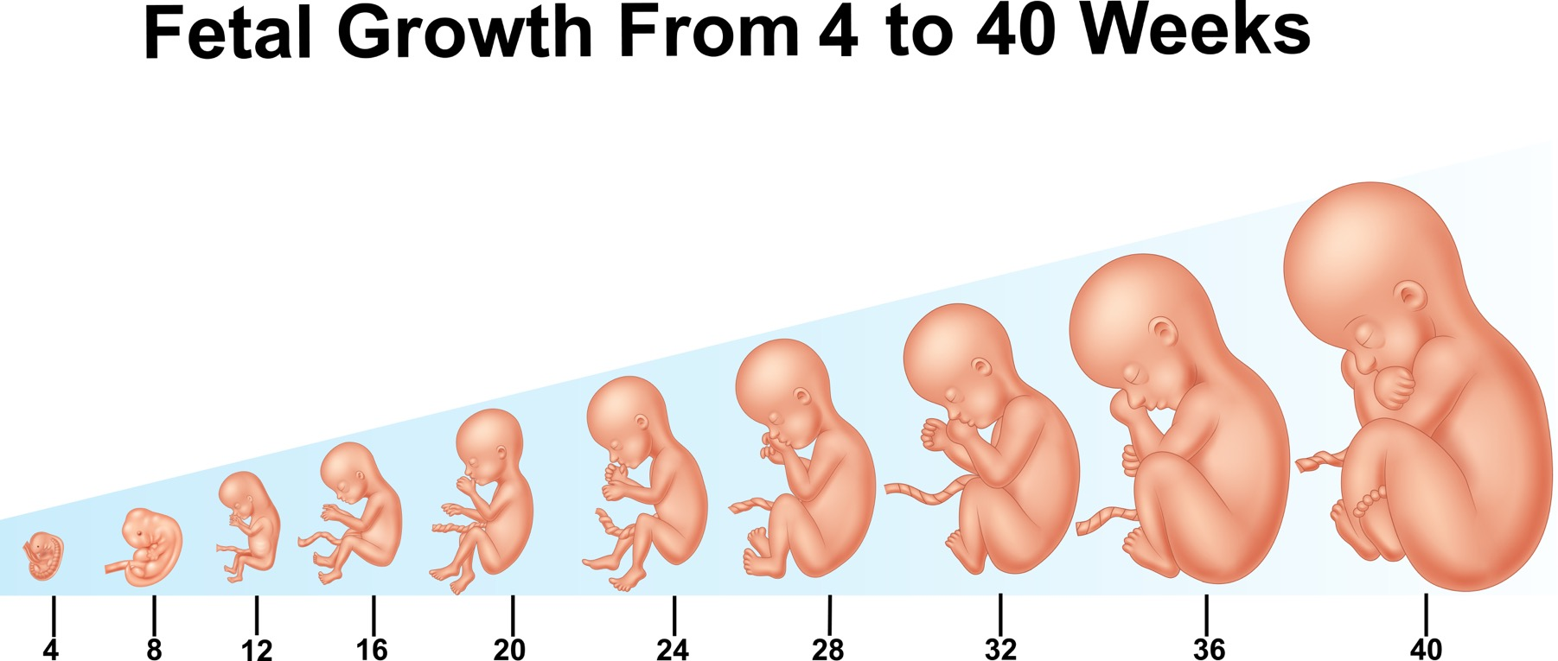
How a baby develops during pregnancy (duration 4 minutes 17) https://youtu.be/h82ltr84_Yg

Slide 44
Now that we have heard more about pregnancy. Lets review all the things we said a mum and baby need to be healthy, happy and safe?
Anything to add now?

Slide 45
Part 3
How a baby is born

Slide 46
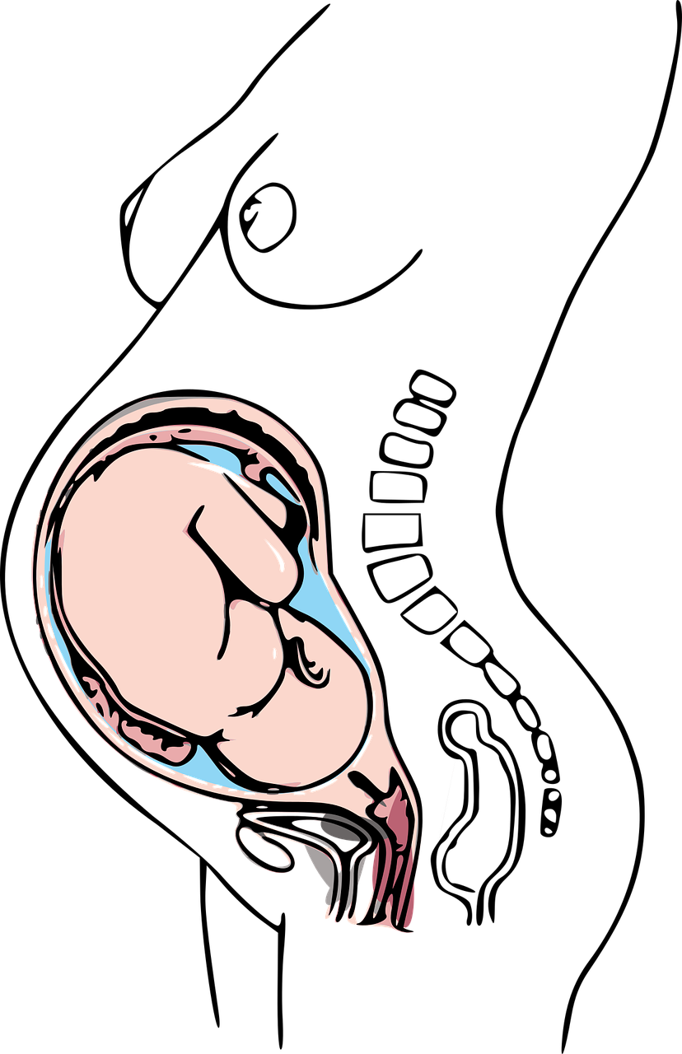
How a baby is born.
After 9 months of being safe and cosy inside the womb it is time for the baby to be born.
The baby changes its position so that the head is downwards getting ready to come out.

Slide 47
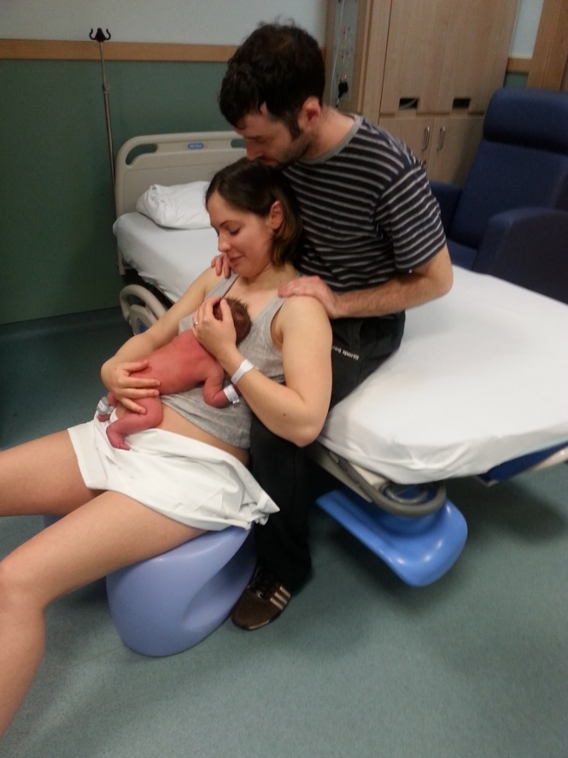
The woman feels some pains in her tummy and she feels the need to push down so that the baby can come out.

Slide 48
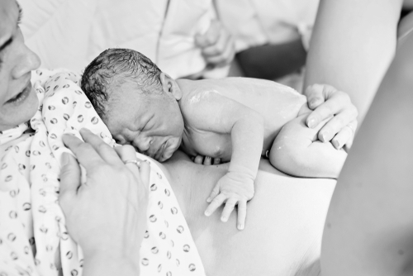
The baby comes down from the womb out of the woman’s vagina. This can take a few hours.
If the baby is unable to come out of the woman’s vagina then her tummy might be cut open instead. This is called a caesarean.
Notes:
Nearly all babies are born this way but some babies can’t be born like this and a doctor has to make an opening in the mummy’s tummy to lift the baby out – this is called a Caesarean.

Slide 49
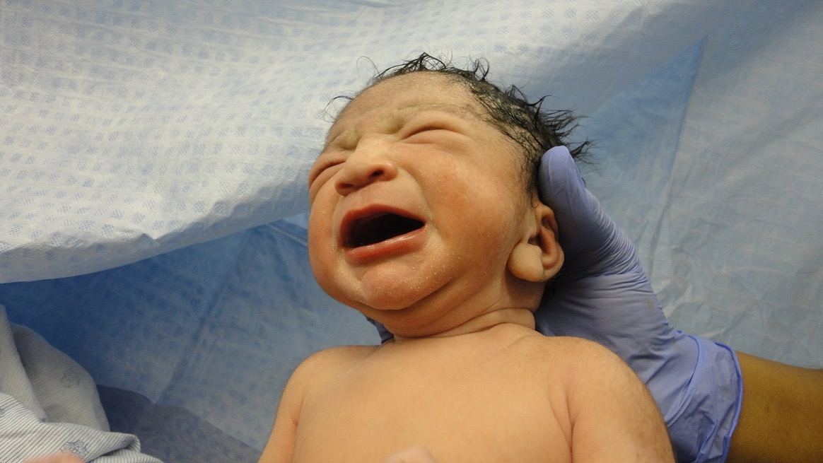
The baby will cry as it leaves the womb and enters the world.

Slide 50
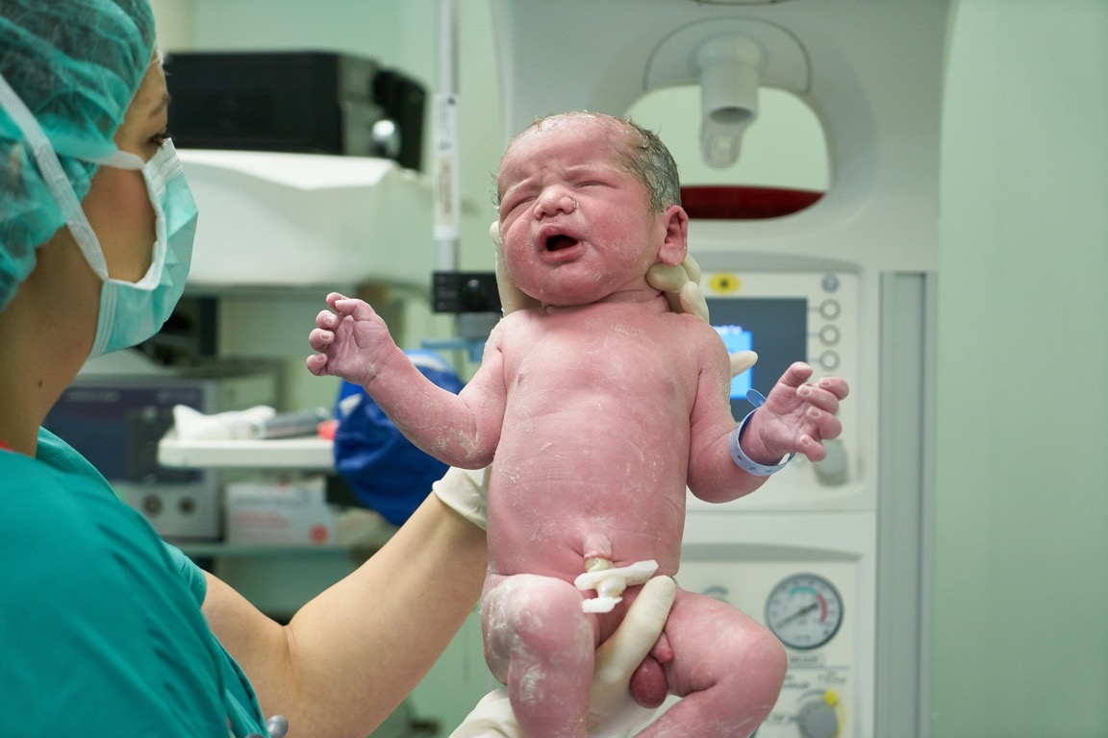
The umbilical cord is cut and then the baby is separate from the mum.

Slide 51
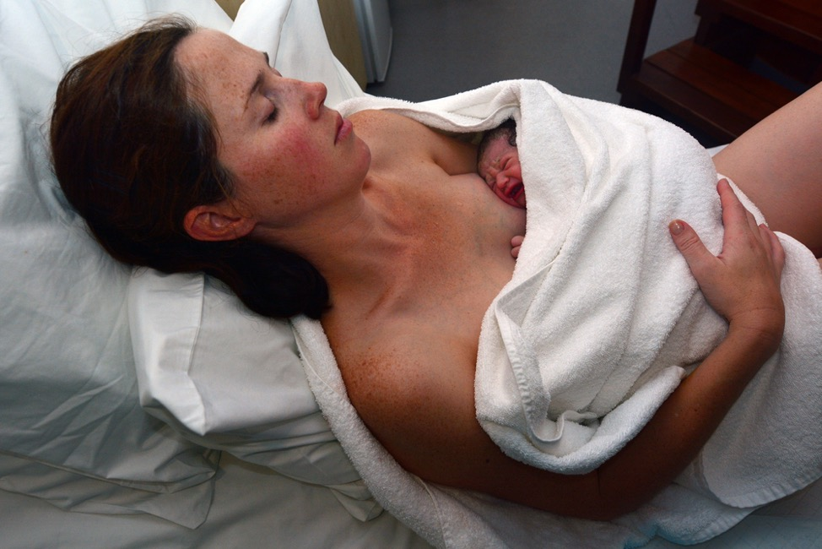
Some babies are born in hospital.
Some babies are born at home.
The dad or partner or friend or other family member can be there to help and support the woman.

Slide 52
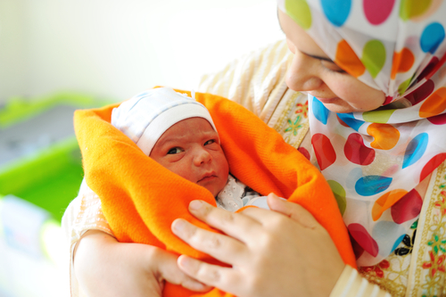
Isn’t it amazing how human life begins!

Slide 53
What babies need

Slide 54
I can explain how human life begins, what pregnancy is and how a baby is born.
I know, understand and can discuss some of a baby’s basic needs such as feeding, changing, washing, cuddling and sleeping.
I can demonstrate some basic skills needed to look after a baby.

Slide 55
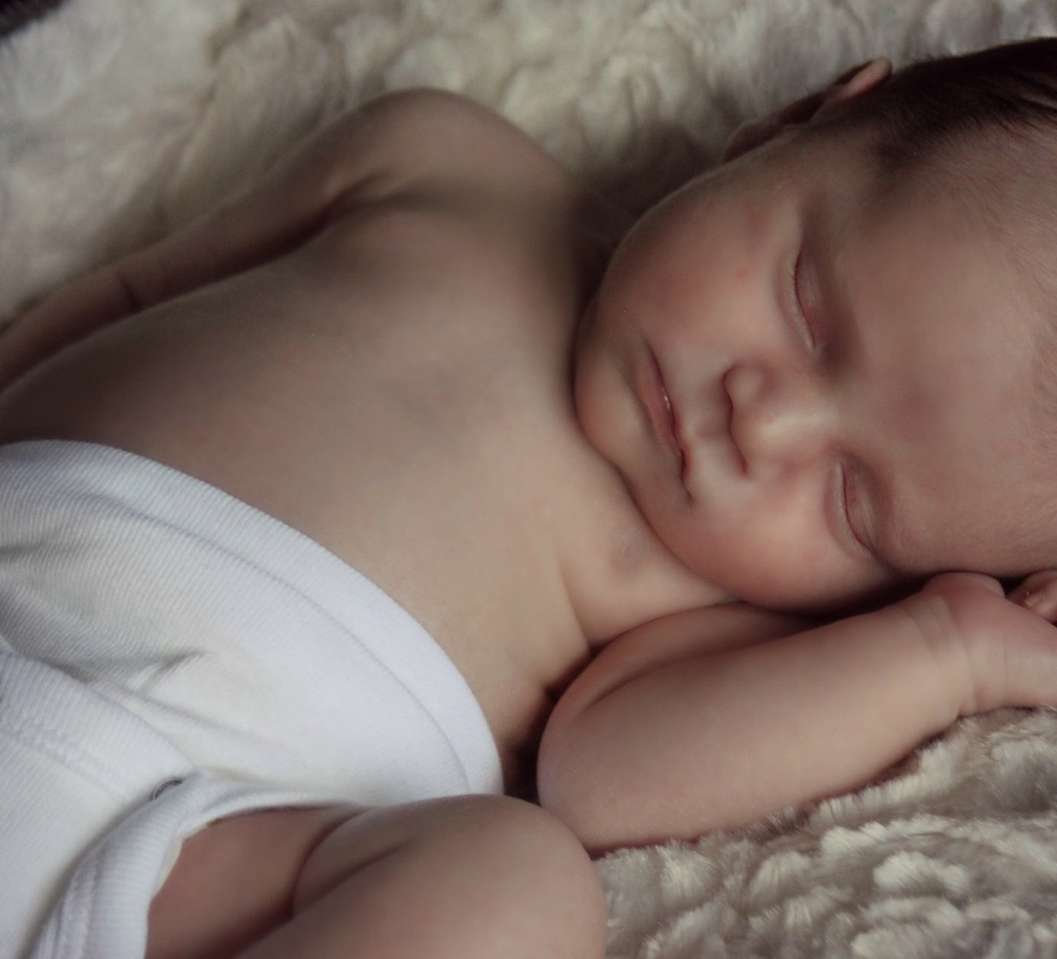
Getting ready for a baby
Imagine that you are planning for the arrival of a new baby.
Work together to make a list of all the things a family needs to do to prepare for their baby.

Slide 56
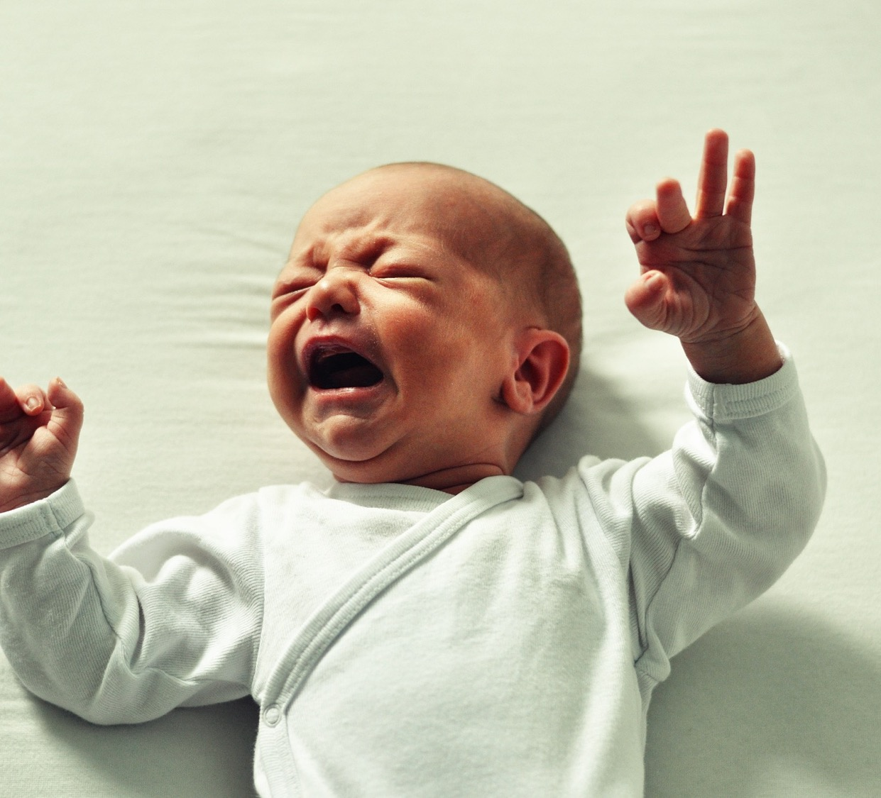
Baby crying sound: https://youtu.be/SuGyPmzHUBE

Slide 57
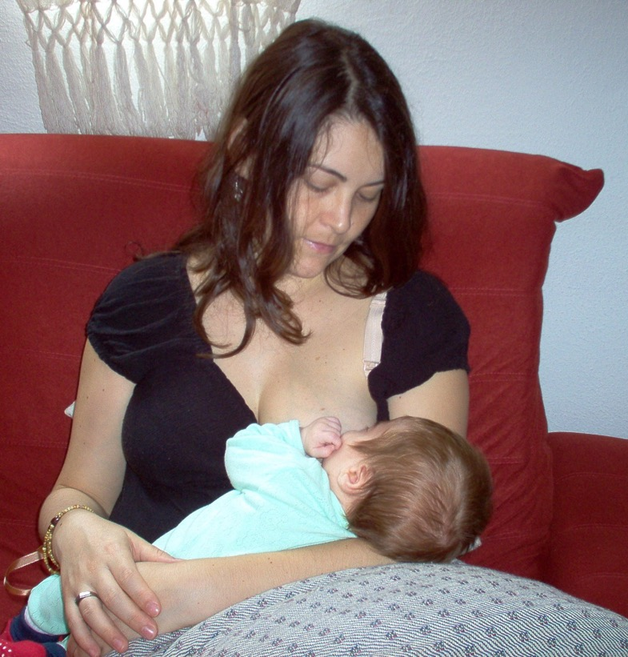
Breastfeeding is good for baby and mum
Breast milk is tailor-made for the baby and gives them all the nutrients they need.
Breast milk helps the baby to fight illness and infection. Breast milk is at the perfect temperature and is very easy to do anywhere with little preparation required.
Sometimes babies are bottle fed instead. This requires quite a bit of preparation but it does mean anyone can do it.

Slide 58
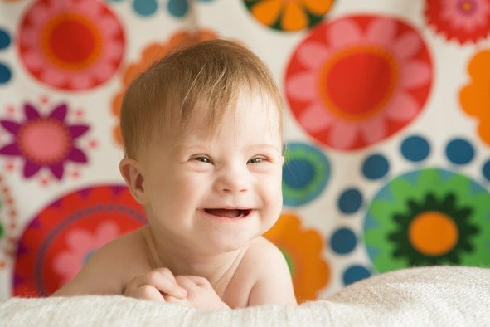
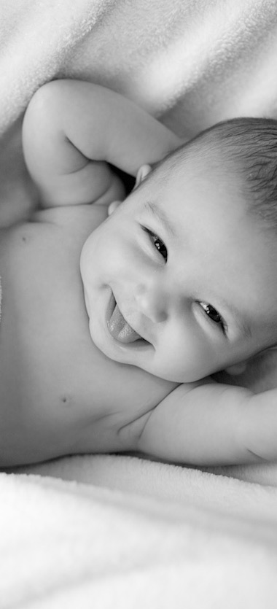
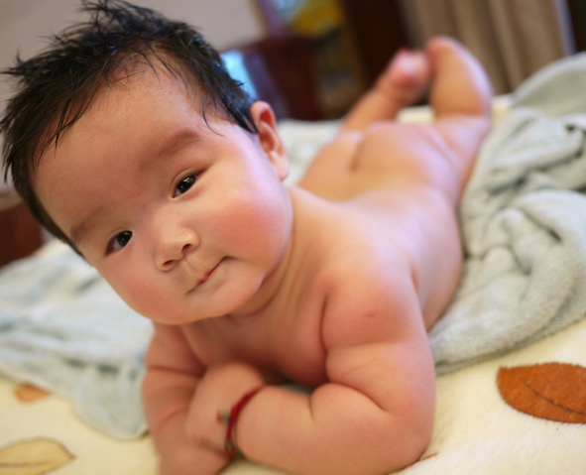
Other than milk, what else do you think a newborn baby might need?

Slide 59

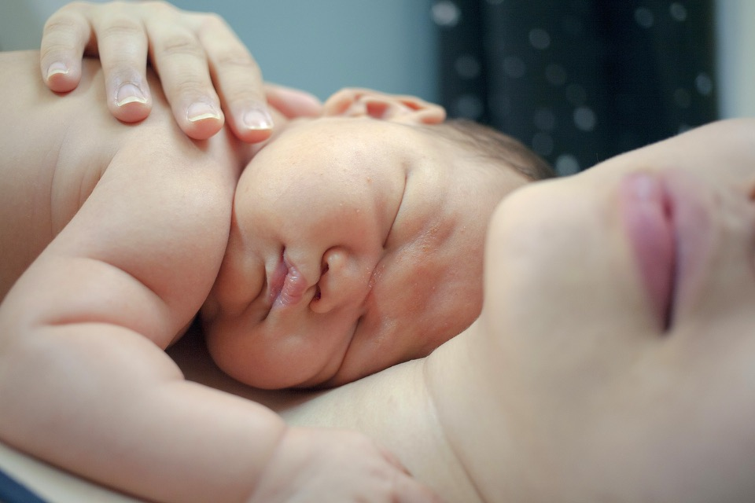
24 hours with a new born baby
https://youtu.be/m9QndNXcnCU

Slide 60
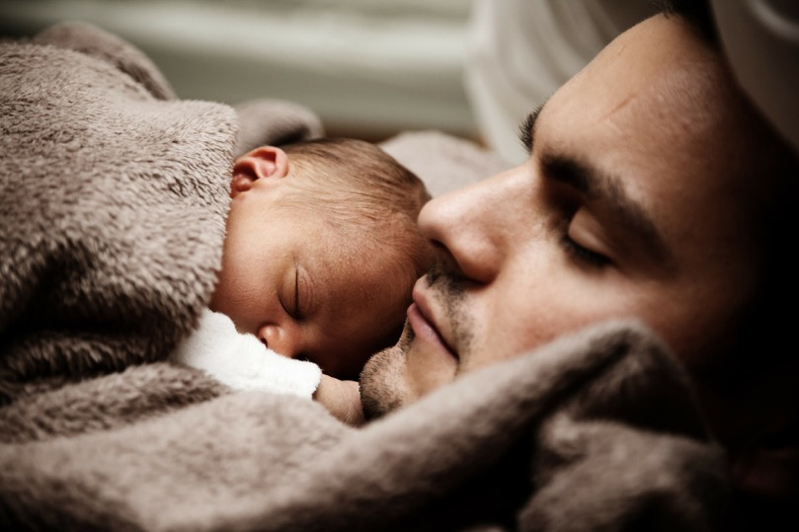
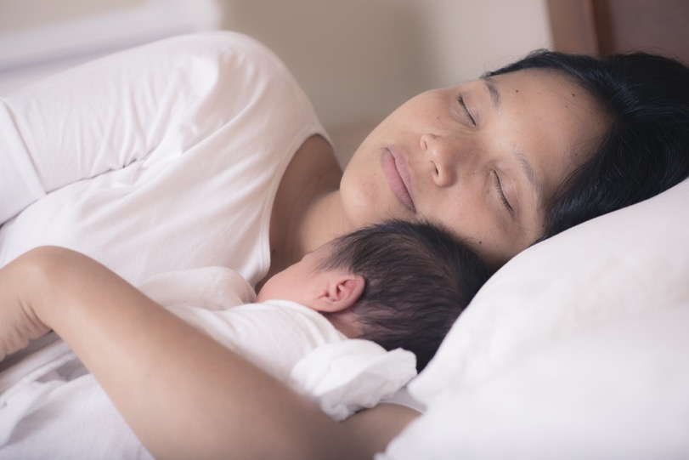
What would be the best thing about being a mum or dad?
What would be the hardest thing about looking after a baby?
Who thinks they would like to be a parent one day?

Slide 61
Visitor…
We will have a visitor to the classroom (or as an online session) to find out first hand about looking after a newborn and what it is really like.

